Slide 1

Next Steps: Undergraduate
MTSU International Affairs
October 28, 2025
Spring 2026 Semester

Slide 2

Next Steps Overview
I-20 Issued
Student Accounts
Placement Tests
New to Blue Orientation
Housing and Immunizations
International Check In

Slide 3
I-20
Financial Statement Form
Financial Support Document ($36,500)
Passport

Slide 4
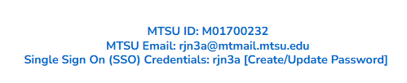



Student Accounts
Update account from your application portal
SSO for several platforms: MT Mail, Pipeline,
Health Services, Housing, etc.
Will only receive official correspondence through MT Mail

Slide 5

Placement Tests
Required for students to enroll
Virtual and In-person options
May be exempt with SAT or ACT scores
Complete these EARLY

Slide 6
Placement Tests Process
Contact University Studies: University.studies@mtsu.edu
Student sent checklist and link to English Survey
Once checklist complete, voucher is sent to students
Must pay test fee to Accuplacer ($28) and MTSU ($25)
University Studies sends results

Slide 7

New to Blue Orientation
Online Modules
Meet with Advisor
Register for Courses

Slide 8
New to Blue Orientation Process
Must be admitted
Register on your Pipeline
We will send email with google doc
Complete google doc to register for virtual session
You will be updated manually
Monitor your email!

Slide 9
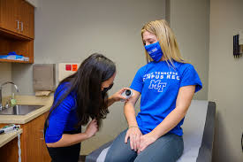
Immunization Requirements
Must have Varicella and MMR immunizations to register full time
Must have Meningitis immunization to live on campus
Can submit documentation to Health Services
Can receive immunizations upon arrival

Slide 10
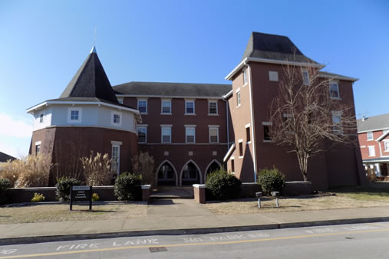
Housing
Not required to live on campus
Separate application to live on campus
Off campus options available, many very close
We cannot get you housing

Slide 11
International Check-In
Digitally submit Visa, I-94, and signed I-20
Attend International Orientation
Sign up for Welcome Week events

Slide 12

Questions?

