Slide 1

International Orientation
December 18, 2025

Slide 2

Overview
Student Accounts
Student Services
Immigration Compliance
Insurance
Academic Integrity
Arrival

Slide 3

Student Accounts

Slide 4
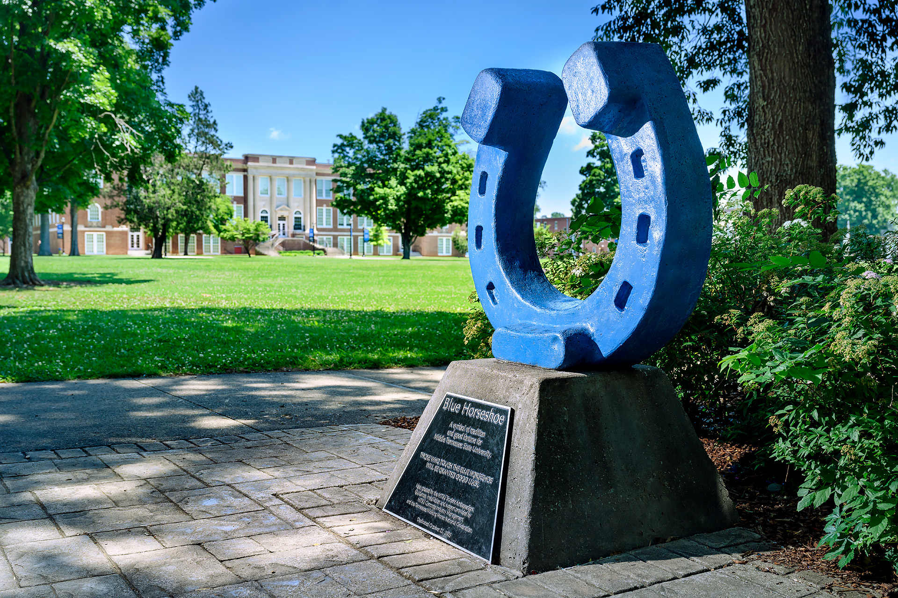
Student Accounts
Pipeline
MT Mail
SSO

Slide 5
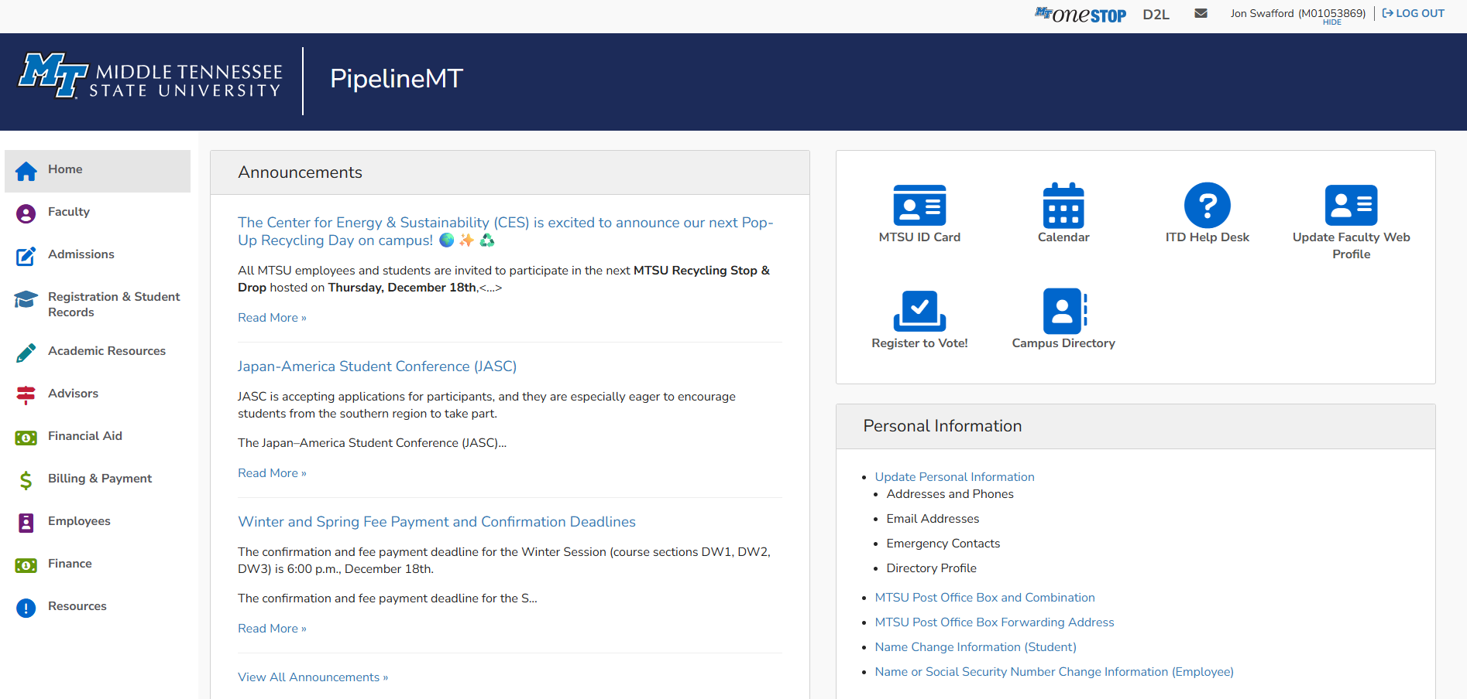
Pipeline Navigation
Home Page

Slide 6
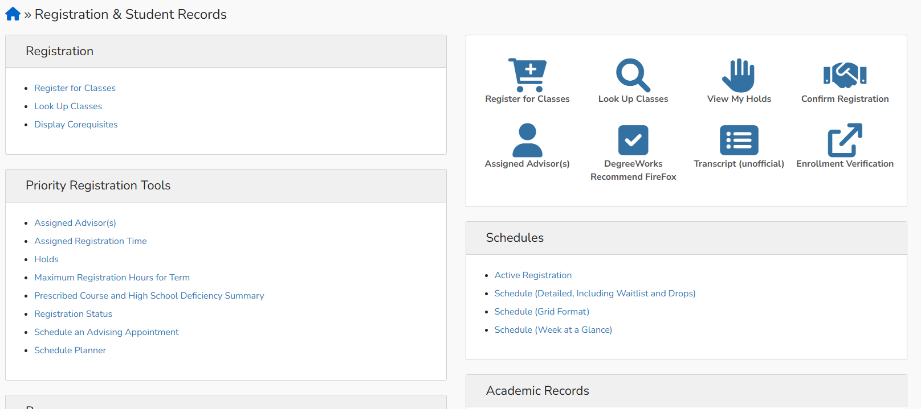
Pipeline Navigation Continued
Registration

Slide 7
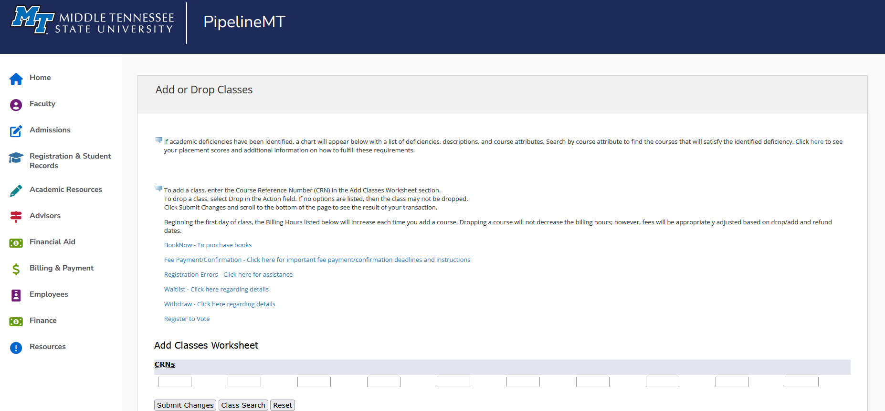
Pipeline Registration Screen

Slide 8
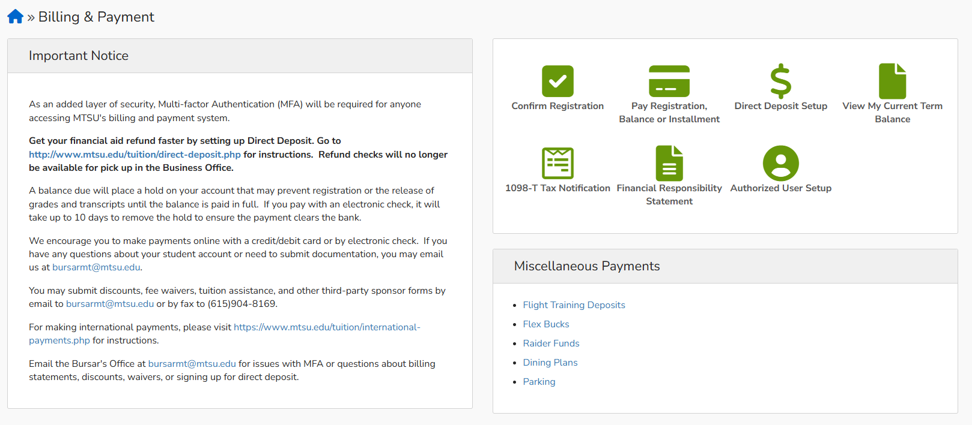
Pipeline Navigation continued
Billing & Payment

Slide 9
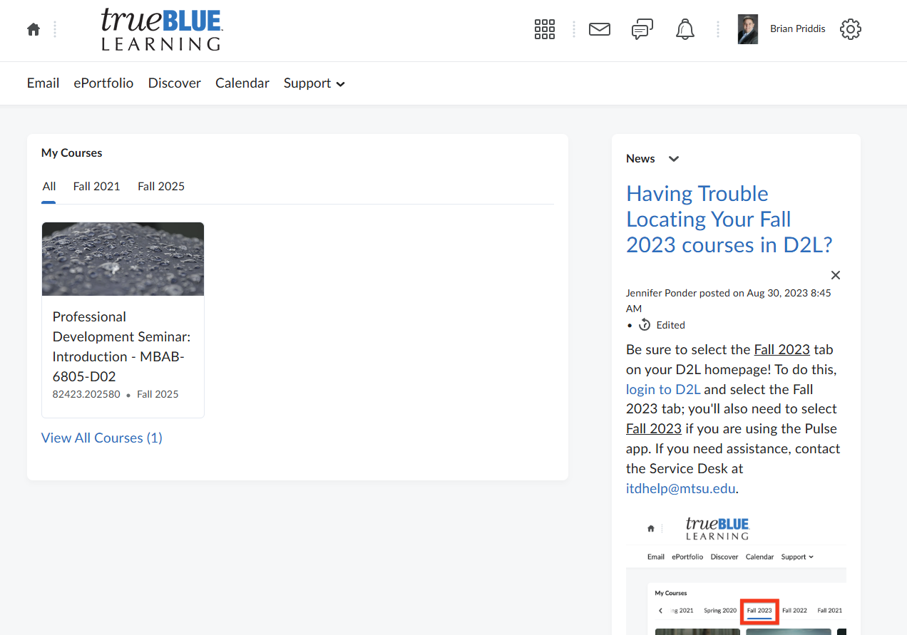
D2L Home Screen

Slide 10
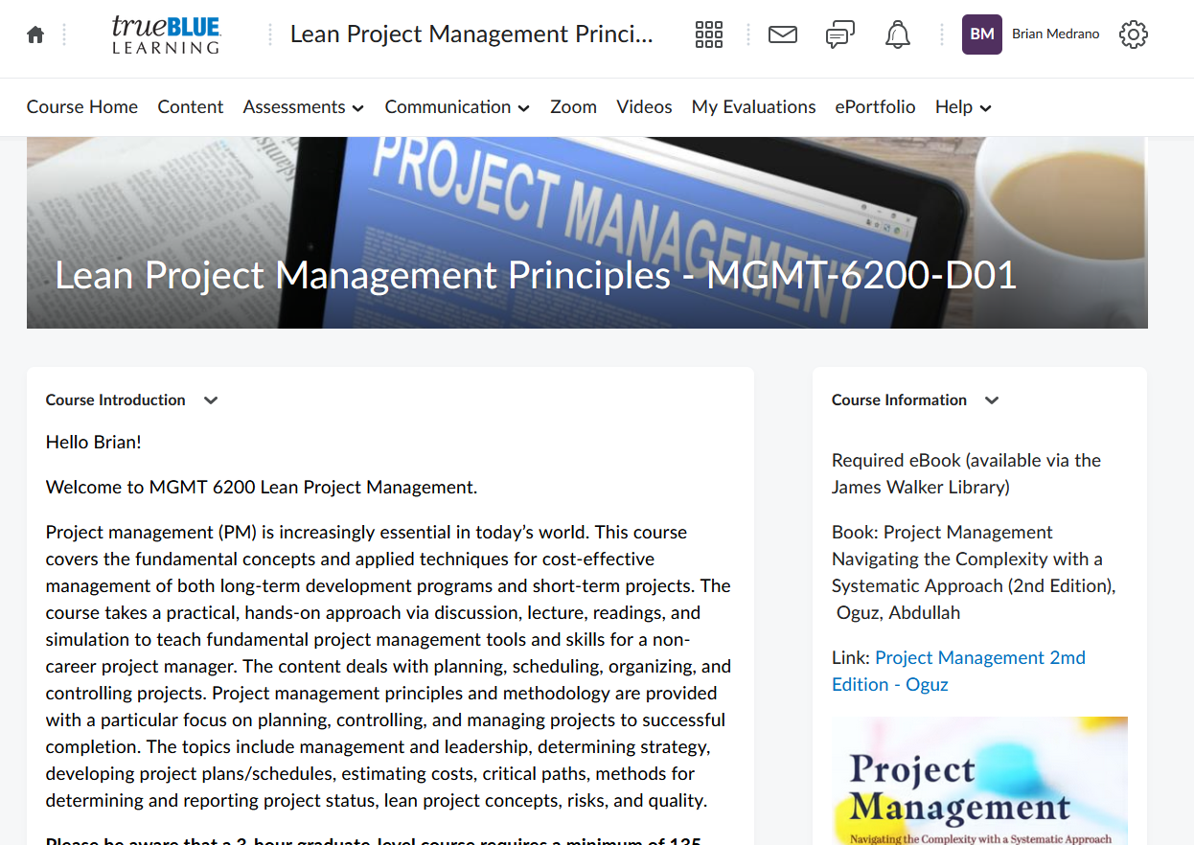
D2L Course screen

Slide 11

Student Services

Slide 12
Student Services
MTSU Police Department
Dedicated Police force of 45 officers
Raider Patrol, Emergency Call Boxes, and self-defense classes
Office of Student Success
Dedicated to providing resources for your success
Tutoring, Writing Center and Supplemental Instruction
Health Services
Routine medical services, vaccinations, and pharmacy
Can also assist with insurance

Slide 13
Student Services
Counseling Services
Training counselors and Psychiatrists free services for students
Let’s Talk, Short-Term Counseling, Referral Services
Academic Advisors
Specialized for your major, only responsible for Academic Advising
Course registration and selection, major changes, degree mapping
Career Development Center
Finding jobs while attending and after graduating
Resume assistance, Job fairs, interview skills, and Raider Closet

Slide 14

Immigration Compliance

Slide 15
Immigration Compliance SEVIS and USCIS
SEVIS – Student and Exchange Visitor Information Program
An online database that stores student I-20s (F students) and DS-2019s (J students). Updated regularly by the Designated School Officer.
USCIS – United States Citizenship and Immigration Services
The federal agency that manages the nation’s lawful immigration system.

Slide 16
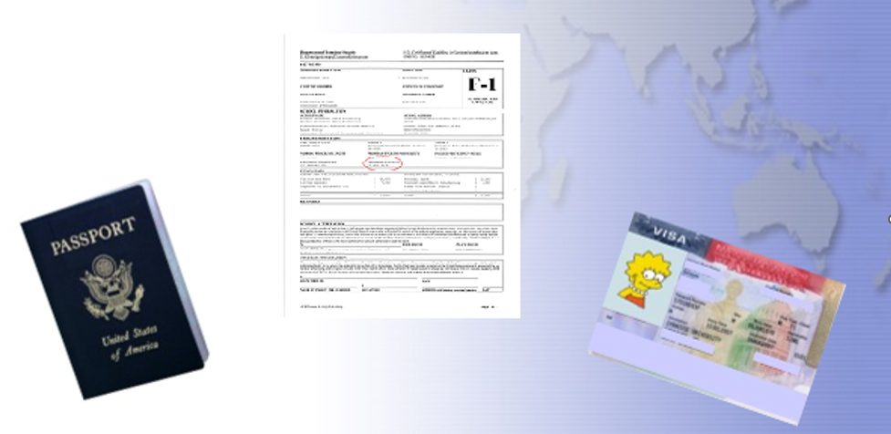
Identifying Documents

Slide 17
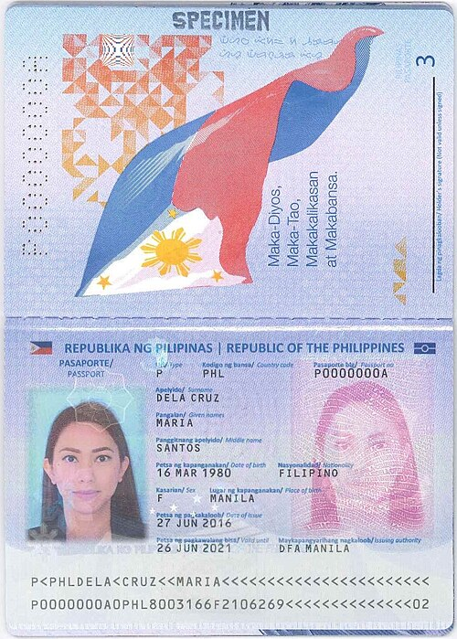
Title Subhead
Maintain a valid passport at all times while in the U.S.
Know your expiration date. Renew prior to expiration (6 months ahead).
Contact your home country consulate or embassy in the U.S. for renewal information.

Slide 18
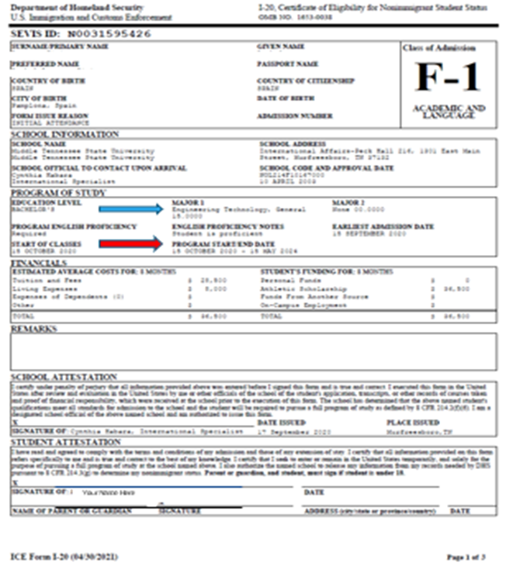
I-20
Personal/Institutional information
Program Start and End dates, know your end date
Level and program of study, must reflect current and accurate information
Have I-20 endorsed before travel outside of the U.S.

Slide 19
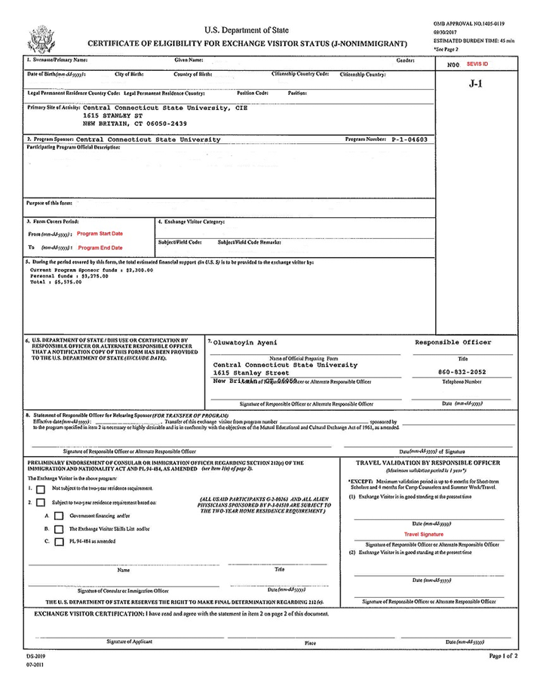
DS-2019 Subhead
Review document for accuracy
Be aware of program end dates
Must reflect accurate information
Have it endorsed prior to travel outside the U.S.

Slide 20
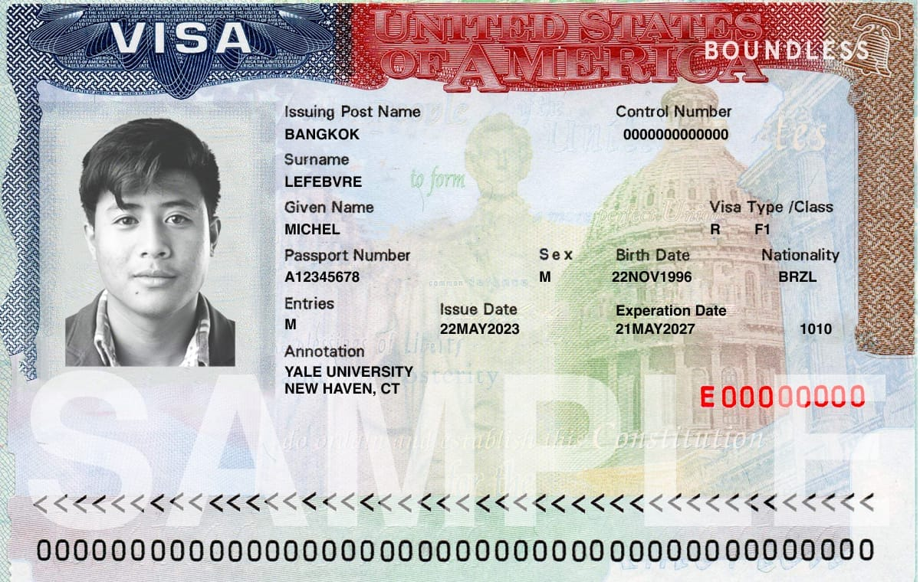
Visa
Visa is the permit to enter the U.S.
Visa may expire while attending, must maintain your status
Visa must be valid for entry and re-entry

Slide 21
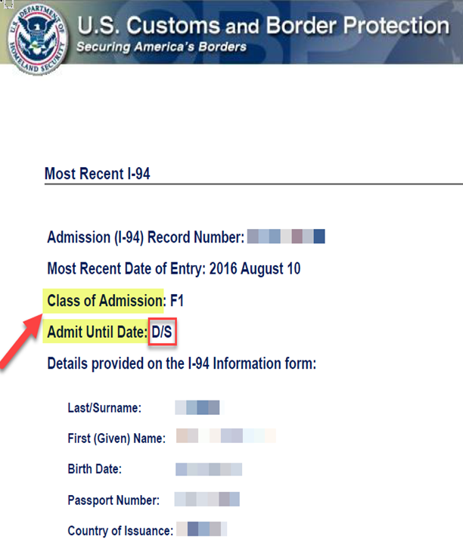
I-94
Arrival – Departure Record
D/S – Duration of Status (includes 60 day grace period)

Slide 22
Compliance Requirements
Enrollment
Documentation
Employment
Post-Completion

Slide 23
Enrollment
Undergraduate
12 hours
9 hours must be on campus
Graduate
9 credit hours*
6 must be on campus
Online Courses
Hybrid courses are on campus
1 online course each semester
Academic Progress
Undergraduate - 2.0 GPA
Graduate – 3.0 GPA
Doctoral – 3.25 GPA

Slide 24
Documentation
Passport
6 months ahead
I-20
Know your program end date
Update for major changes
Signature for travel authorization
Contact
Must update your address and phone number
SEVIS requirement to maintain status
10 days to update after changing address or phone number

Slide 25
Employment
Location
On campus during semester
Off campus only with authorization
Hours
Part-time, 20 or fewer hours per week during semester
Practical Training
CPT – while attending, connected to course
OPT – post completion
Webinars during semester
Application
Utilize the Career Development Center
We cannot get you a job
Library, Dining Services, Departments

Slide 26
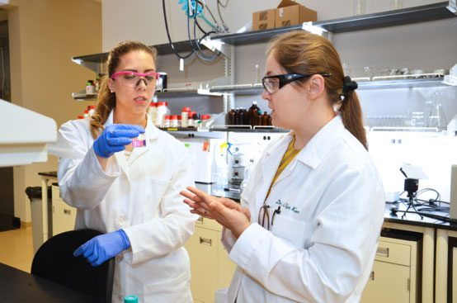
Graduate Assistantships
We cannot provide an updated I-20 for students to receive their Social Security Card until after the Census date, February 2nd.
Students cannot be paid until they have received their Social Security Number
Need up to 6 weeks of funding for once you arrive here
We cannot expedite this, the Census date is a federal requirement

Slide 27
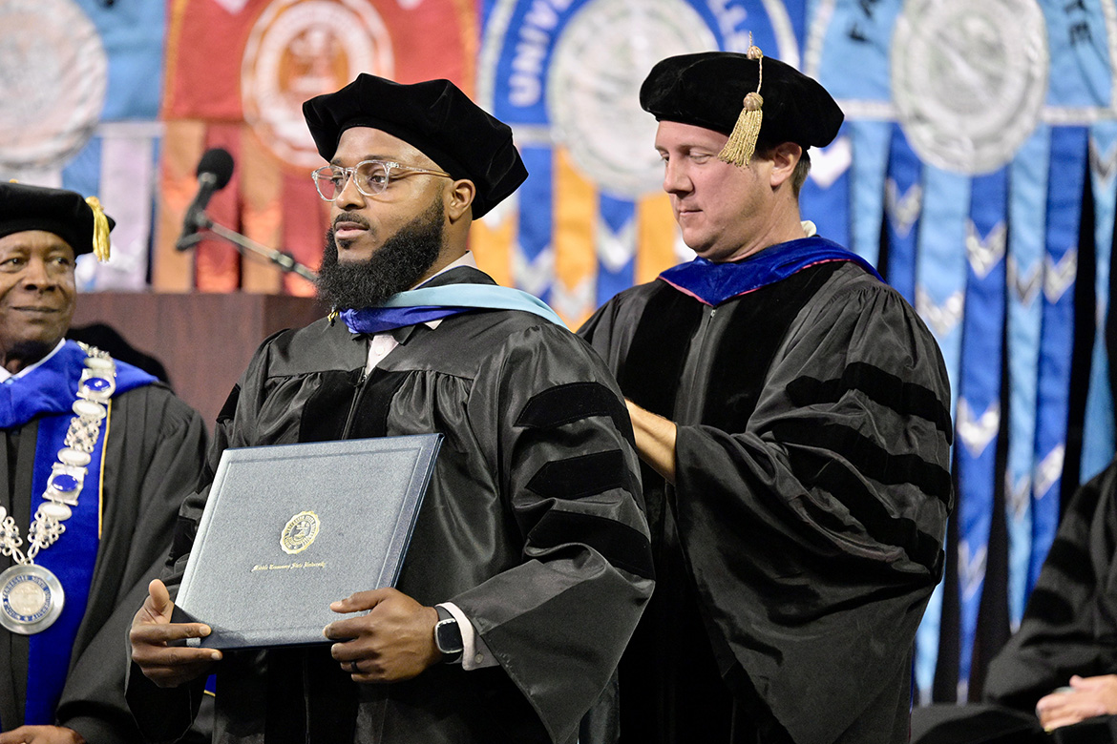
Post Completion
Grace Period
60 days
Transfer or change level, return home, change of status, apply for OPT

Slide 28
Compliance Things to Remember
You are responsible for maintaining your immigration status
Be aware of your document expiration dates
You must enroll full time every semester and maintain enrollment
Do not work off campus or over 20 hours without authorization
We are here to help!!

Slide 29

Insurance

Slide 30

Insurance
Insurance coverage is an immigration requirement for students attending on the F-1 and J-1 visa
MTSU provided insurance is mandatory for F-1 and J-1 students
Dependents are also required to be insured
Spring insurance covers Summer semester as well
Our insurance provider is Wellfleet

Slide 31
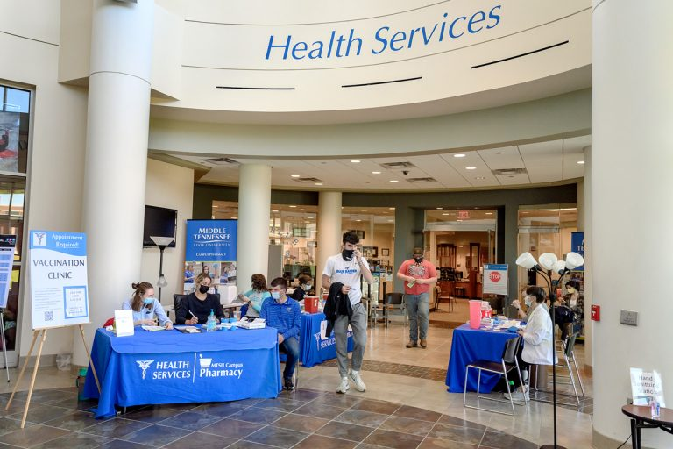
Insurance Things to remember
Health Services can assist with most medical issues, they should be your first stop
Can help with finding off campus provider
You are responsible for medical costs including co-pays and deductibles
Emergency room is only for emergencies

Slide 32
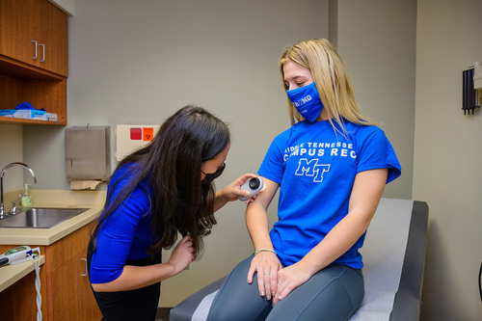
Insurance continued
Insurance premium is added to student account
Enrolled and covered once you register
Covers immunizations
Will send information for insurance card

Slide 33

Academic Integrity

Slide 34

Academic Integrity
Academic Integrity is considered a very serious matter in the United States
If suspected of violating academic integrity students can be expelled from the university
Violations are reported to the Office of Student Conduct who review the case

Slide 35
Academic Integrity
Plagiarism
Taking another person’s words, statements, images, or works as your own without giving credit
Cheating
Using, or attempting to use, materials, information, or aids in any academic exercise, or working with a classmate without permission
This applies to Examinations as well as assignments
Fabrication
Unauthorized falsification or invention of any information or citation in an academic exercise

Slide 36

Academic Integrity AI
The use of AI is becoming increasingly common
Professors have mechanisms of finding work completed using AI
Unauthorized use is a violation of Academic Integrity

Slide 37
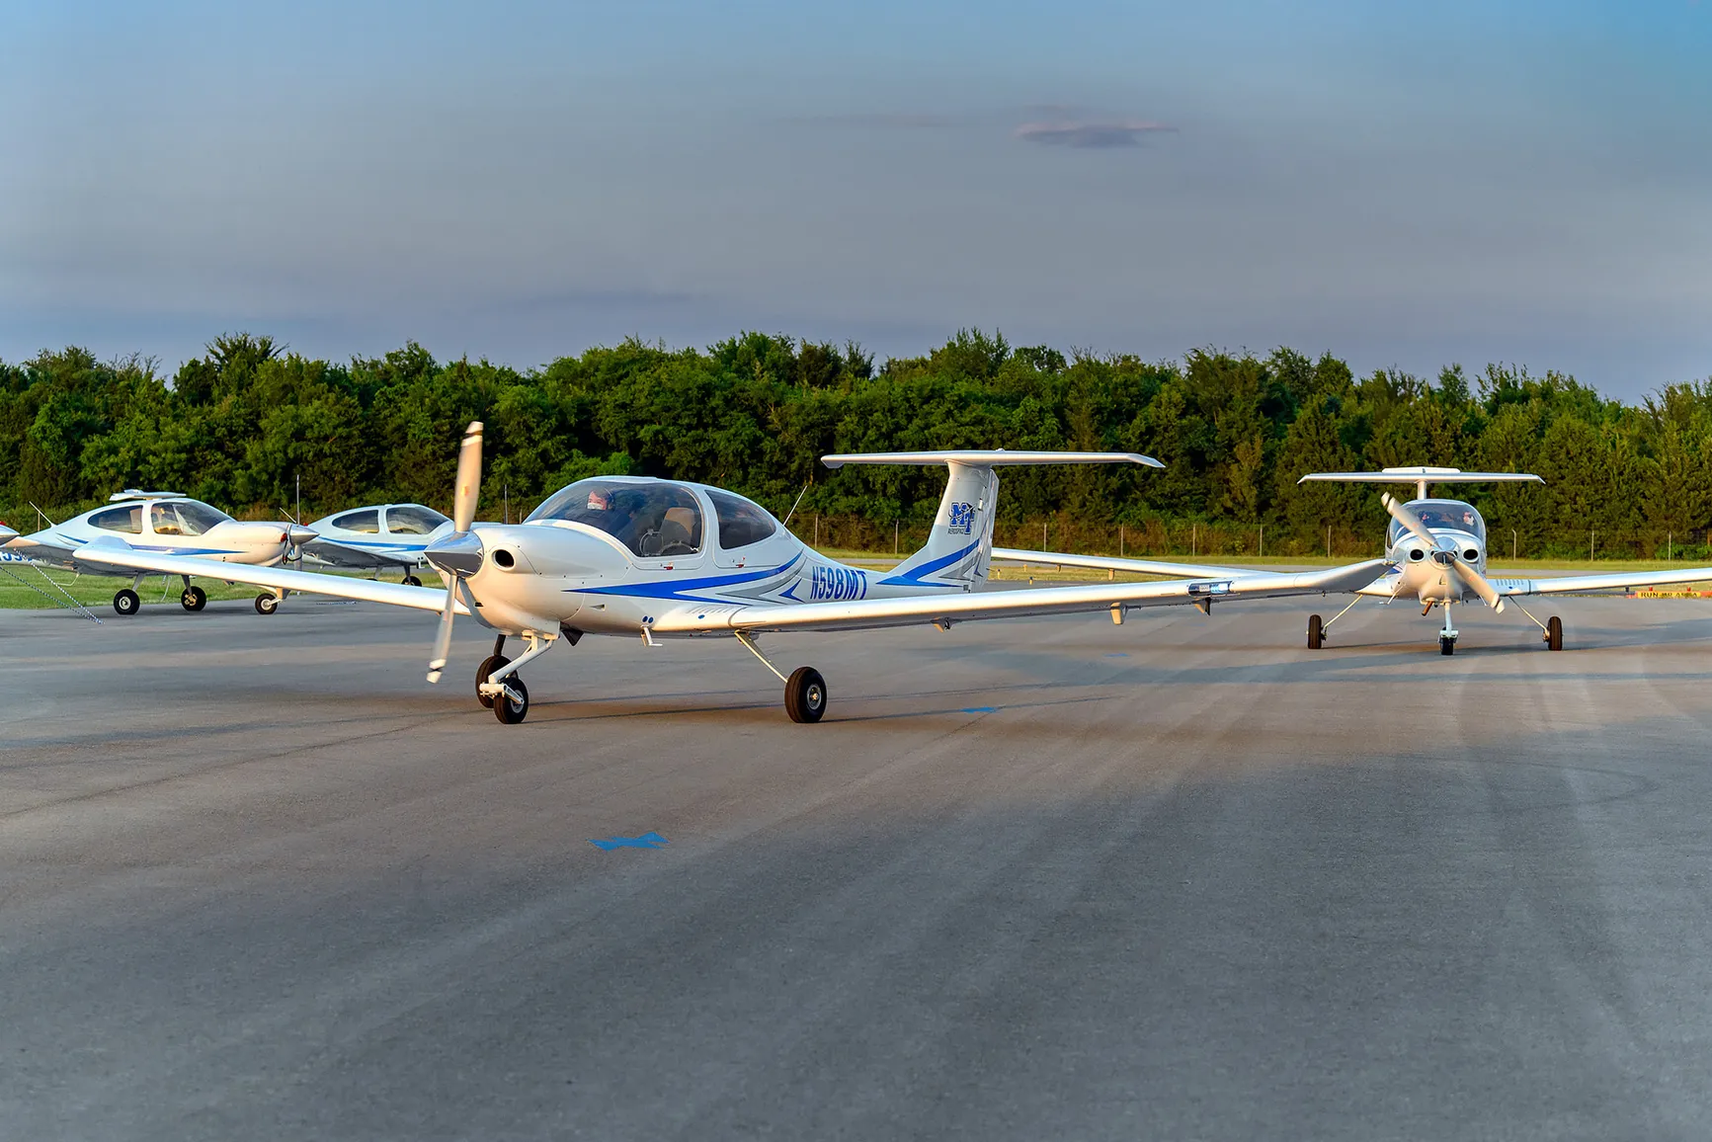
Arrival

Slide 38
Arrival Entering the U.S.
All immigration documents in carry on bag
When you land in the U.S., prepare for border patrol
Know connection time and gate
Be polite and answer all questions
Prepare to have phone and PC checked
Have MTSU contact information
When finished, go to connecting gate

Slide 39
Arrival Entering U.S. continued
Entering the U.S.
Border patrol
Documents
Acceptance Letter
GA Letter
Scholarship
Visa, passport
Purpose for entering U.S.

Slide 40

Arrival In Murfreesboro
In Murfreesboro
Check in with the International Affairs office
Visa, Signed I-20, I-94, local address
Email Documents to Interntaional@mtsu.edu

Slide 41

Arrival Final Steps
Next Steps should be completed
Register for courses
Sign up for Welcome Week events

Slide 42
Questions?

