Slide 1


Visa Interview and Pre-arrival

Slide 2

SEVIS and USCIS
SEVIS – Student and Exchange Visitor Information Program
An online database that stores student I-20s (F students) and DS-2019s (J students). Updated regularly by the Designated School Officer.
USCIS – United States Citizenship and Immigration Services
The federal agency that manages the nation’s lawful immigration system.

Slide 3
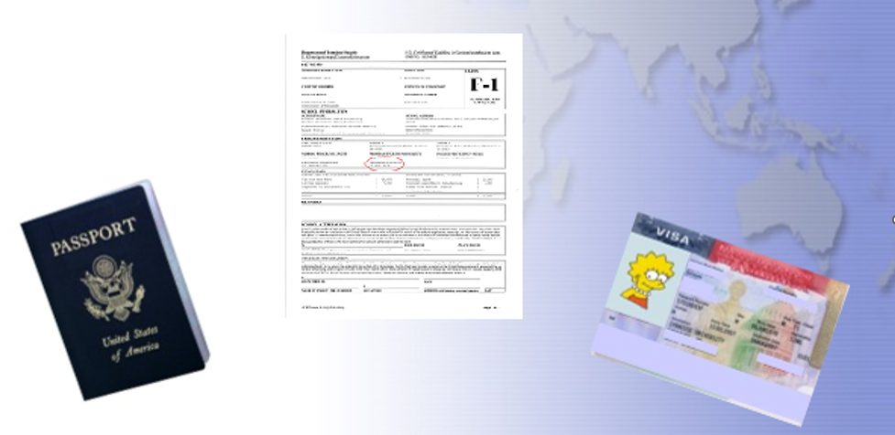
Identifying Documents

Slide 4
Obtaining an I-20
Passport
Must be valid 6 months into the future
Submit Financial Documents
Current Bank statement $36500 or more
I-20
I-20 will be issued and emailed to your MTSU account
Financial Affidavit

Slide 5
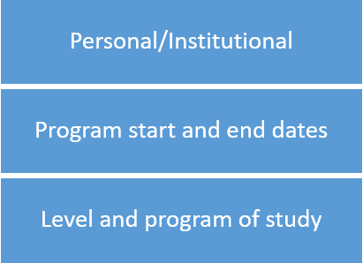
The I-20; Identifying Information

Slide 6
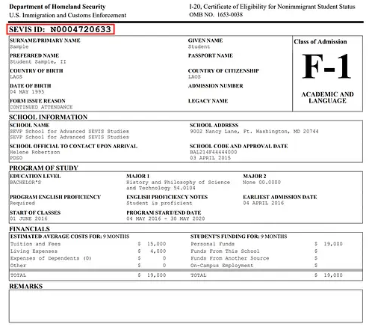
The I-20; Knowing your document, part 1

Slide 7
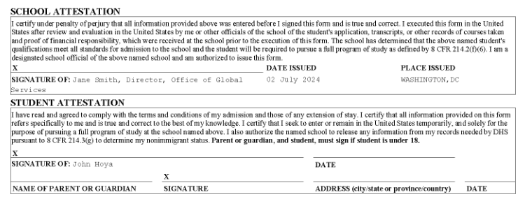
The I-20; Knowing your document

Slide 8
What are my next steps after I receive my I-20?
Pay the SEVIS 901 fee of $350
Complete the DS-160 application
Schedule visa interview

Slide 9
What to take with you to the Visa interview?
Passport
Valid 6 months into the future
MTSU Acceptance Letter
Major, Start date
Financial Documents
Bank Statement, Graduate Assistant Letter
Scholarship offer letter

Slide 10
The Visa Interview
The interview will:
be conducted in English.
last approximately 4 minutes.
REMINDER
Prepare – schedule a mock interview at ISSS@mtsu.edu
Relax – lean on your preparation
Dress like a student
When referring to currency, speak in USD
Be honest
Be specific

Slide 11

The Visa Interview Important Questions
Where and what are you studying?
Why USA? Why MTSU?
How will you fund your education?

Slide 12
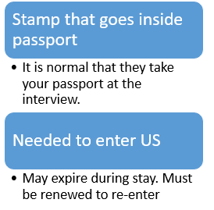
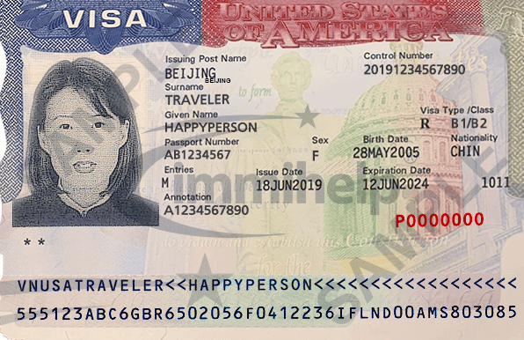
The Visa Stamp

Slide 13
Maintaining Status:
Undergraduate
Graduate
12 hours minimum
9 on-ground
3 online
Minimum 2.0 GPA
9 hours minimum
6 on-ground
3 online
Minimum 3.0 GPA

Slide 14

Travel Preparations and Arrival

Slide 15
Prior to Leaving
Decide travel dates, book tickets
Secure Housing
Complete Next Steps
Make a Packing List
Pack your Bags!
Confirm your flight arrangements
Confirm transportation arrangements
Confirm your housing accommodations

Slide 16
Entering the U.S.
All immigration documents in carry on bag
When you land in the U.S., prepare for border patrol
Know connection time and gate
Be polite and answer all questions
Prepare to have phone and PC checked
Have MTSU contact information
When finished, go to connecting gate

Slide 17
Entering the U.S. contd.
Entering the U.S.
Border patrol
Documents
Acceptance Letter
GA Letter
Scholarship
Visa, passport
Purpose for entering U.S.

Slide 18
Arriving to Murfreesboro
In Murfreesboro
Check in with the International affairs office
Check in dates are August 18 & 19
Email Docs before checking in

Slide 19
QUESTIONS?

