Slide 1

Next Steps
Graduate Admission
Notes:
Welcome everyone! This presentation will walk you through the essential next steps for newly admitted international graduate students.
We’ll cover topics like immigration documents, housing, scholarships, orientation, and more.

Slide 2

Topics
I-20
Student Accounts (PipelineMT and email)
Graduate Assistantships
Immunizations
Housing
International Orientation (mandatory)
CGS Orientation (optional)
Contacting your advisor/program
Deferrals/Change of program request
Notes:
Here’s a quick overview of what we’ll cover today.
Each item is a key step in preparing for your graduate studies at MTSU.
Feel free to jot down questions as we go—we’ll have time for Q&A at the end.

Slide 3
I-20
Issued once you have been:
-Admitted into your degree program
-We have received a copy of passport, signed Financial Support Form, financial documents
Financial Documents:
Bank statements
Assistantship award letter
Scholarship award letter
Notes:
The I-20 is your official document for obtaining an F-1 visa.
It’s issued after admission and once we receive your passport, financial support form, and financial documents.
These documents can include bank statements, assistantship offers, or the IMS

Slide 4
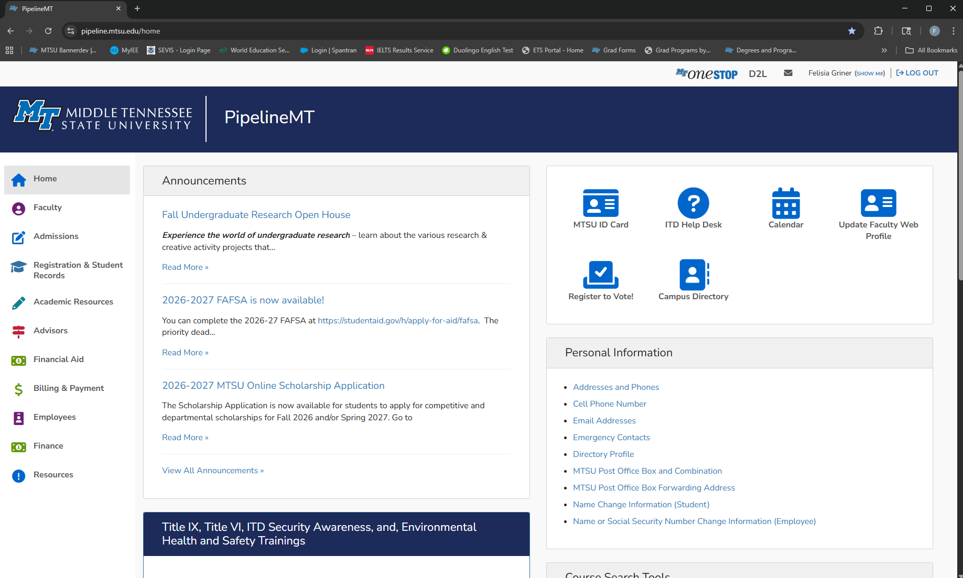
Student Account
PipelineMT
https://pipeline.mtsu.edu/home
Notes:
PipelineMT is your student portal for accessing your account, registration, and more.
Make sure you log in and get familiar with it early.

Slide 5
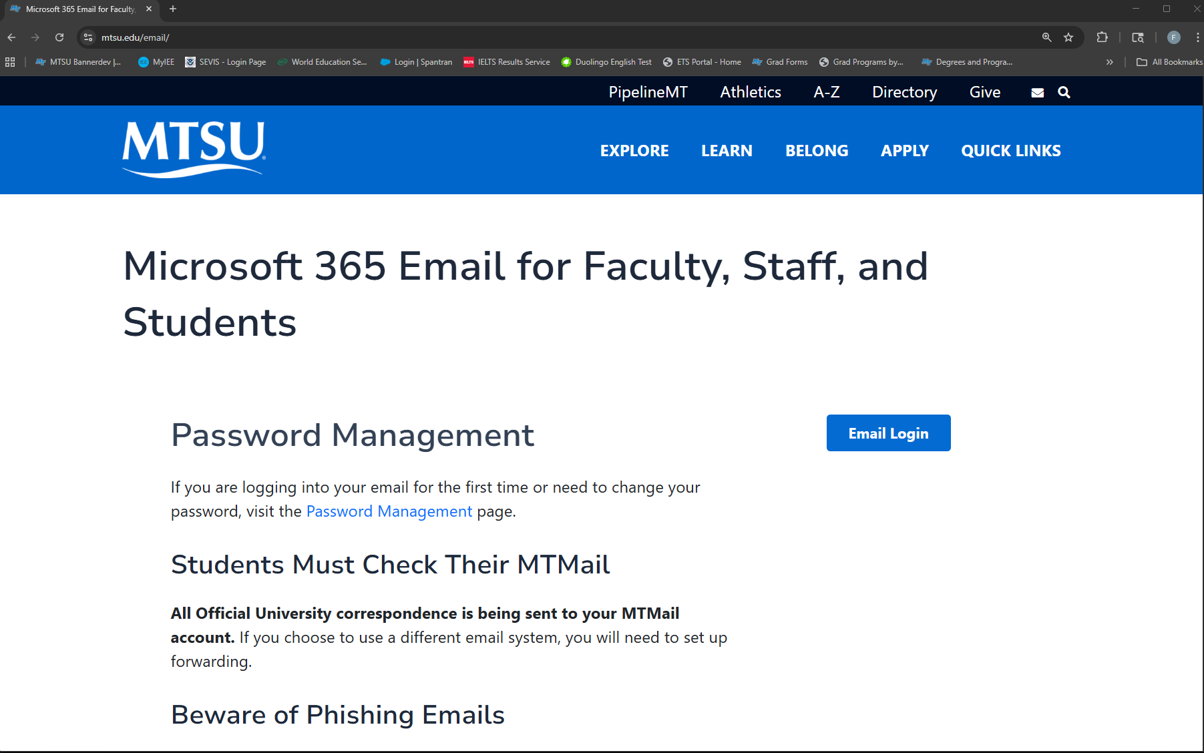
Student Account
Email
https://www.mtsu.edu/email/
Notes:
Your MTSU email is the official way we communicate with you.
Check it regularly for updates on registration, scholarships, and orientation.

Slide 6
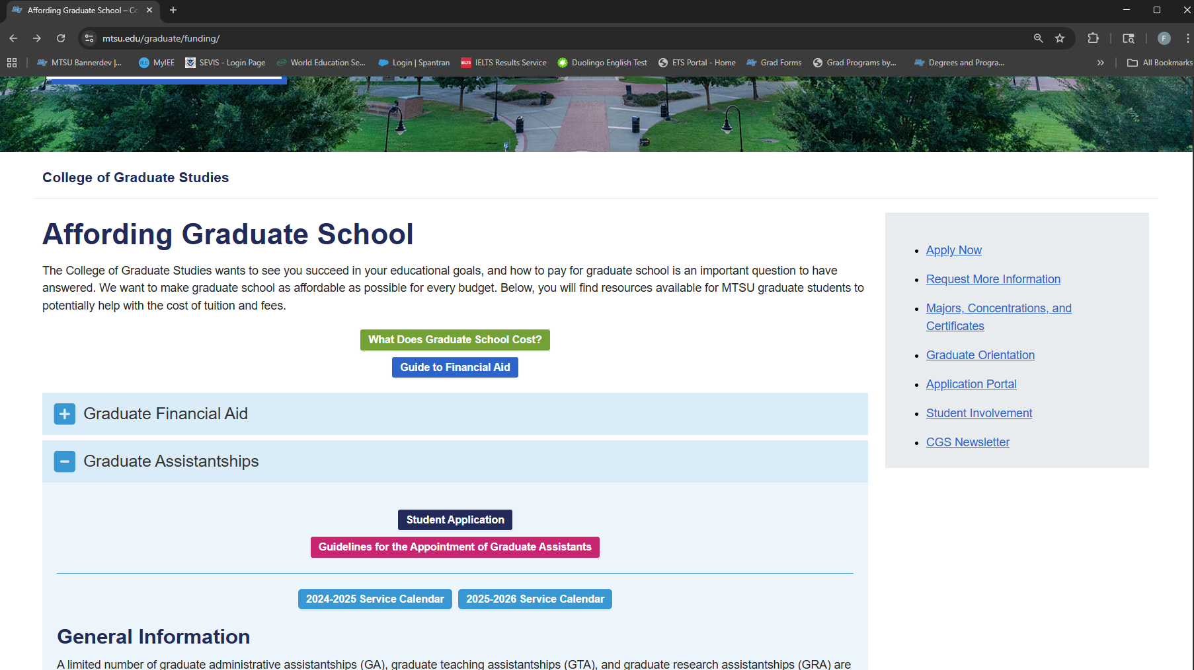
Graduate Assistantship
https://www.mtsu.edu/graduate/funding/
Apply early!
Individual application for each position,
you may apply to more than one
Contact individual office(s) for status
Student-driven process!
Notes:
Assistantships are competitive and require early application.
You can apply to multiple offices, but you must choose between an assistantship and the International Merit Scholarship.
This process is student-driven, so follow up with departments directly.

Slide 7
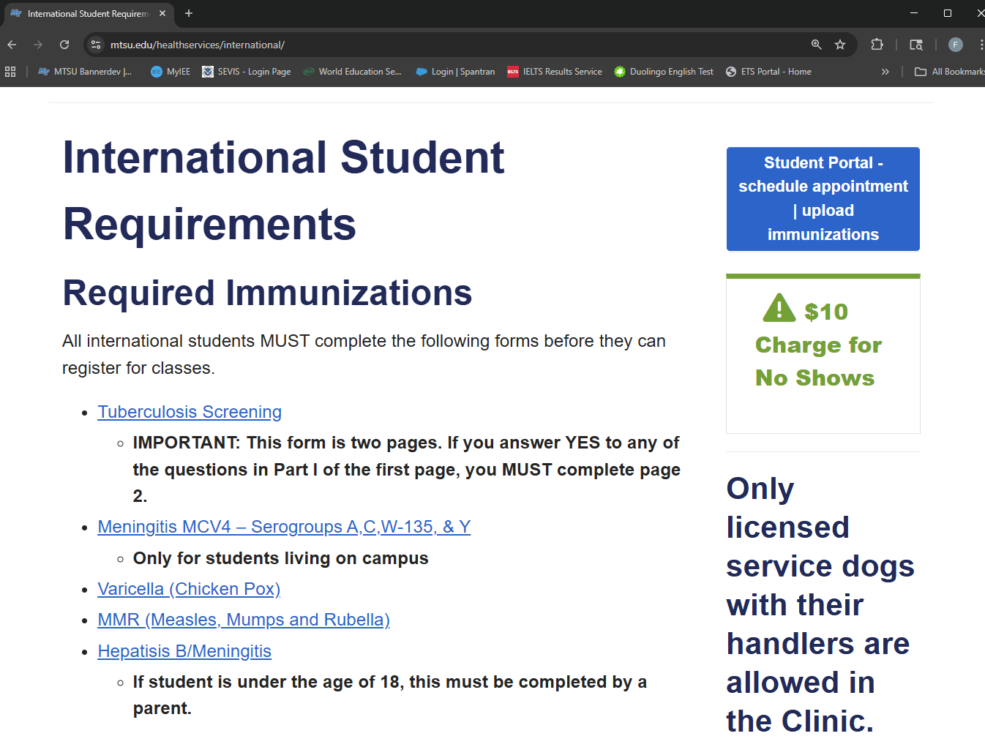
Immunizations
All F-1 students must complete the immunization requirement
You must complete the immunization requirement to enroll full-time and live on campus
Follow instructions on the Student Health Services website
Notes:
All F-1 students must meet immunization requirements to enroll full-time and live on campus.
Visit the Student Health Services website for instructions.

Slide 8
Housing
On Campus:https://www.mtsu.edu/living-on-campus/
You are not required to live on campus
Apply early as housing fills up fast
Immunizations required
Off Campus:https://offcampushousing.mtsu.edu/listing
Many options available
Student-driven – our office is unable to assist with housing
YOU ARE RESPONSIBLE FOR THE HOUSING CONTRACT YOU SIGN!
Notes:
On-campus housing is optional but fills up quickly—apply early!
Off-campus housing is available, but our office cannot assist with contracts.
Be sure to read and understand any housing agreement you sign.

Slide 9
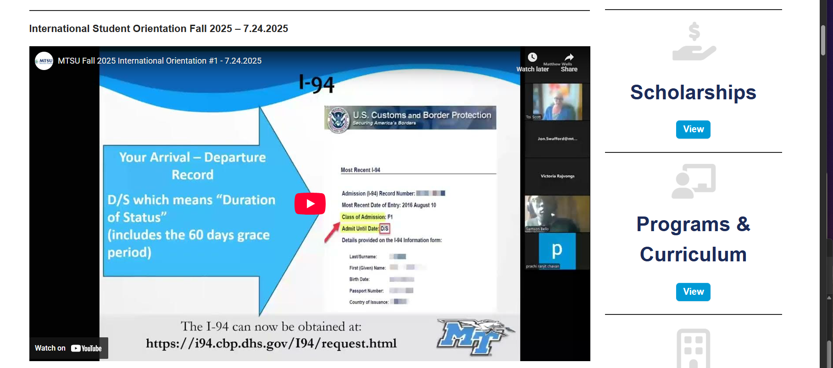
International Orientation
Required for all F-1 students
International Orientation Webinars - https://intered.mtsu.edu/webinars/
Orientation Quiz
Upcoming webinar schedule can be found in the
Events and Activities section:
Orientation Session #1: 28 Jul 2026 – 8:00 CST
Orientation Session #2: 18 Aug 2026 – 8:00 CST
All F-1 students must complete this requirement. A registration hold will prevent you from adding to, or changing your schedule if not completed by the hold date
Notes:
This orientation is mandatory for all F-1 students.
You must attend webinars and complete the orientation quiz.
A registration hold will be placed if you don’t complete it by the deadline.

Slide 10
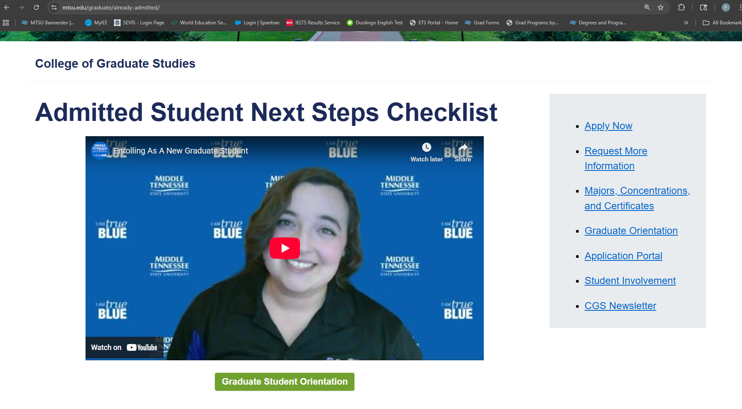
College of Graduate Studies (CGS) Orientation
https://www.mtsu.edu/graduate/already-admitted/
Not required, but is EXTREMELY helpful
Notes:
The College of Graduate Studies orientation is optional but very helpful.
It provides valuable insights into graduate life and resources at MTSU.

Slide 11
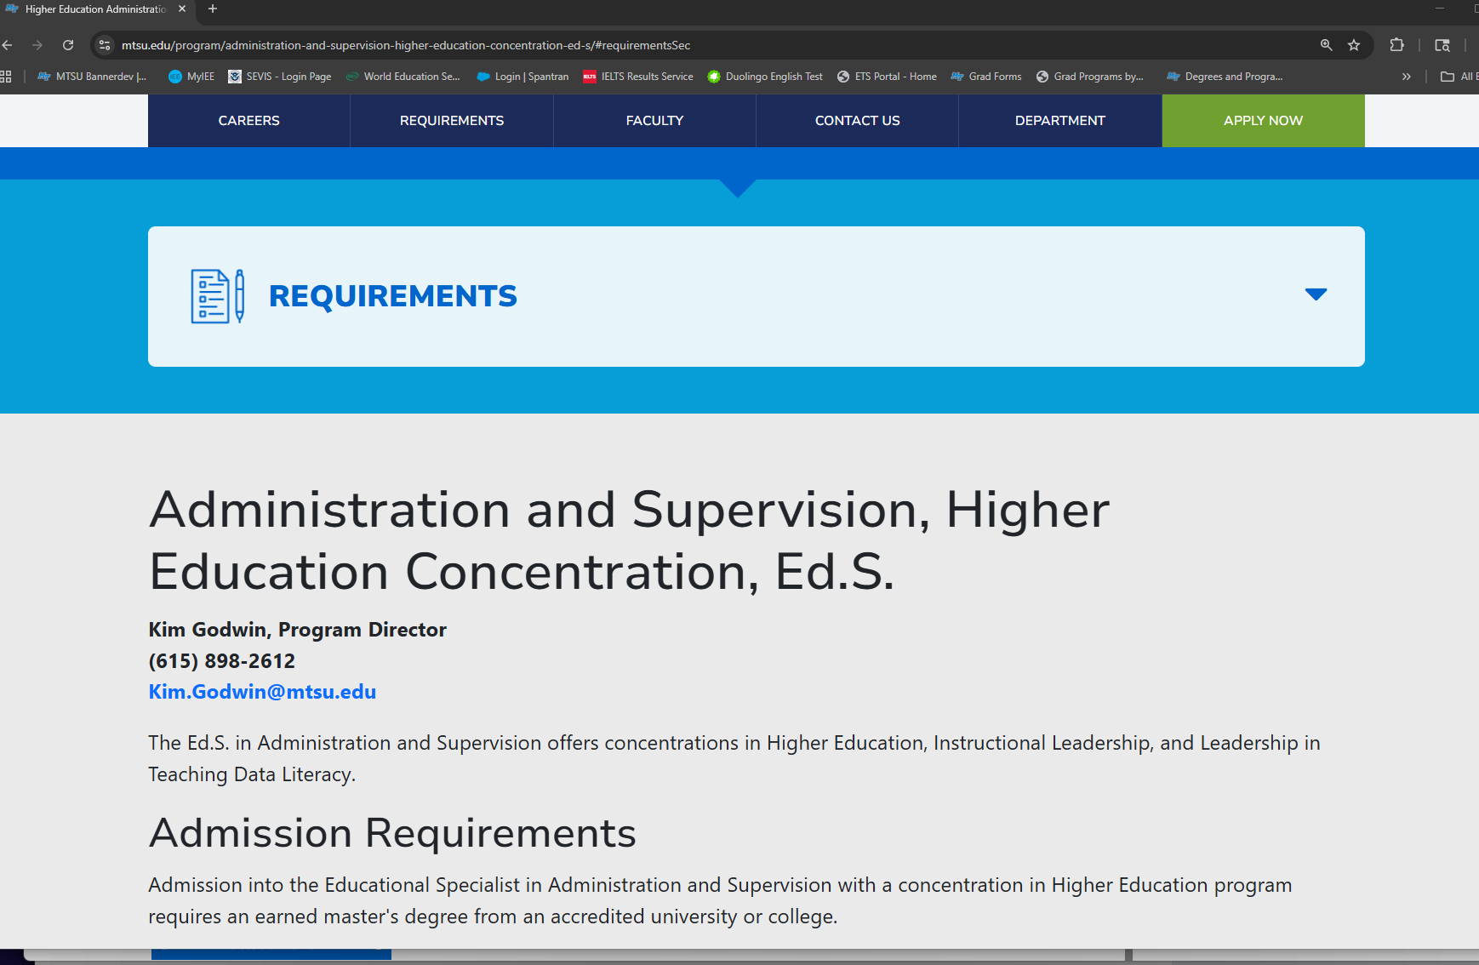
Contact Advisor/Program
HIGHLY encouraged
Additional program requirements
Confirm admission acceptance
Course selection and academic advising
Notes:
Contacting your advisor is highly encouraged.
They’ll help you confirm your admission, guide course selection, and share any program-specific requirements.

Slide 12
Deferring Admission/Changing Programs
Withdraw your current application and submit a new application for the term you plan to attend and/or your intended degree program
No application fee required*
Previously submitted transcripts/test scores will be applied to your new application
May apply previously submitted reference letters to new application as well
Program-specific materials must be uploaded separately
Note:
Meeting minimum requirements for program admission does not guarantee admission, as applicants are selected on a competitive basis.
Previous decisions do not apply to the new application
*if previously paid and the application is for the same level
Notes:
If you need to defer or change your program, withdraw your current application and submit a new one.
No new fee is required if it’s for the same degree level.
Previously submitted official documents can be reused, but program-specific materials must be re-uploaded.

Slide 13
Resources
PipelineMT: https://pipeline.mtsu.edu/home
Email: https://www.mtsu.edu/email/
Graduate assistantships: https://www.mtsu.edu/graduate/funding/
Search for Programs: https://www.mtsu.edu/search-program/
Deferring your application: https://apply.mtsu.edu/apply/
Housing: https://www.mtsu.edu/living-on-campus/
Off-Campus Housing: https://offcampushousing.mtsu.edu/listing
Immunizations: https://www.mtsu.edu/healthservices/international/
Registration Guide: https://www.mtsu.edu/registration/registration-guide/
Webinars: https://intered.mtsu.edu/webinars/
Notes:
This slide includes links to all the resources mentioned today.
Bookmark these for easy access to housing, immunizations, assistantships, and more.

Slide 14
Recap:
I-20​ - what is needed
Student Accounts​ - how to access
Contacting your Advisor/Program​ - where to find info, confirm acceptance, program specific info
Graduate Assistantships​ - student driven – submit app(s) and contact office of interest
Immunizations​ - must complete to register full time
Housing​ - student-driven – not required to live on campus
International Orientation (mandatory)​ - must complete to remove registration hold
CGS Orientation (optional)​ - not required, but is good information
Deferrals/Change of program request​ - be aware of program-specific requirements
Notes:
This slide includes links to all the resources mentioned today.
Bookmark these for easy access to housing, immunizations, assistantships, and more.

Slide 15
Questions?
Notes:
Now it’s time for your questions!
Feel free to ask about anything we covered or other concerns you may have.

