Slide 1

Next Steps:
Undergraduate
MTSU International
April 21, 2026
Fall 2026 Semester

Slide 2

Next Steps
Overview
I-20 Issued
Student Accounts
Placement Tests
New to Blue Orientation
Housing and Immunizations
International Check In

Slide 3
I-20
Financial Statement Form
Financial Support Document ($36,500)
Passport

Slide 4
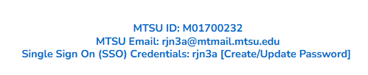



Student Accounts
Update account from your application portal
SSO for several platforms: MT Mail, Pipeline,
Health Services, Housing, etc.
Will only receive official correspondence through MT Mail

Slide 5

Placement Tests
Required for students to enroll
Virtual and In-person options
May be exempt with SAT or ACT scores
Complete these EARLY

Slide 6
Placement Tests
Process
Contact University Studies: University.studies@mtsu.edu
Student sent checklist and link to English Survey
Once checklist complete, voucher is sent to students
Must pay test fee to Accuplacer ($28) and MTSU ($25)
University Studies sends results

Slide 7
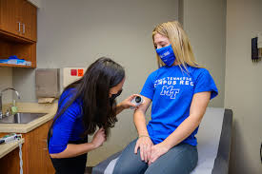
Immunization Requirements
Must have Varicella and MMR immunizations to register full time
Must have Meningitis immunization to live on campus
Can submit documentation to Health Services
Can receive immunizations upon arrival

Slide 8

New to Blue Orientation
Register on Pipeline
Meet with Advisor
Register for Courses
Online Modules
This is a new process
Email Orientation@mtsu.edu if you have questions!

Slide 9
New to Blue Orientation
April 28th
May 15th
June 8th
July 15th
August 4th

Slide 10
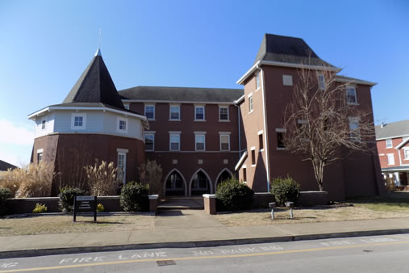
Housing
Not required to live on campus
Separate application to live on campus
Off campus options available, many very close
We cannot get you housing

Slide 11
International Check-In
Digitally submit Visa, I-94, and signed I-20*
Attend International Orientation
Sign up for Welcome Week events

Slide 12
Upcoming Webinars
May 5th –
Visa Interview
May 12th – Culture Shock
May 19th – Student Services
May 26th – Next Steps

Slide 13
International Orientation
July 28th
August 18th

Slide 14

Questions?

