Slide 1


Immigration and the Visa Interview

Slide 2

SEVIS and USCIS
SEVIS – Student and Exchange Visitor Information Program
An online database that stores student I-20s (F students) and DS-2019s (J students). Updated regularly by the Designated School Officer.
USCIS – United States Citizenship and Immigration Services
The federal agency that manages the nation’s lawful immigration system.

Slide 3
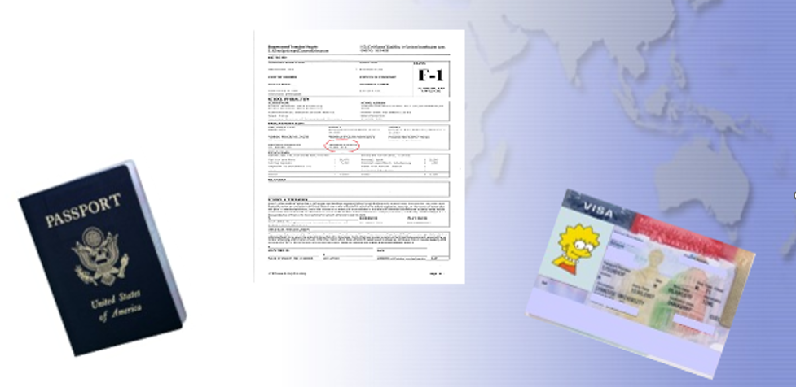
Identifying Documents

Slide 4
Obtaining an I-20
Passport
Must be valid 6 months into the future
Submit Financial Documents
Current Bank statement $36500 or more
I-20
I-20 will be issued and emailed to you
Financial Affidavit

Slide 5
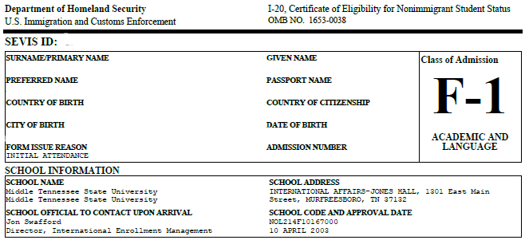
The I-20; Identifying Information
SEVIS ID Number
Basic Student Information
School Information

Slide 6
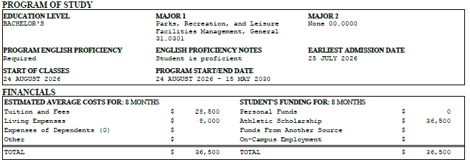
The I-20; Program information
Level and Major of Study*
Program Start/End Date
Financials

Slide 7
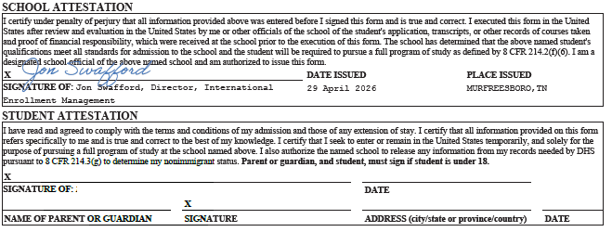
The I-20; Attestation
School Attestation
Student Attestation
Read Page 3!!

Slide 8
What are my next steps after I receive my I-20?
Pay the SEVIS 901 fee of $350
Complete the DS-160 application
Schedule visa interview

Slide 9
What to take with you to the Visa interview?
Passport
Valid 6 months into the future
MTSU Acceptance Letter
Major, Start date
Financial Documents
Bank Statement, Graduate Assistant offer letter
Scholarship offer letter

Slide 10
The Visa Interview
The interview will:
be conducted in English.
last approximately 4 minutes.
REMINDERS
Prepare – schedule a mock interview at ISSS@mtsu.edu
Relax – lean on your preparation
Dress like a student
When referring to currency, speak in USD
Be honest
Be specific

Slide 11
The Visa Interview Important Questions
Where and what are you studying?
Why USA? Why MTSU?
How will you fund your education?

Slide 12
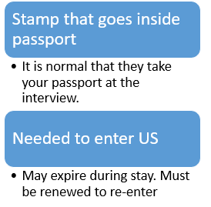
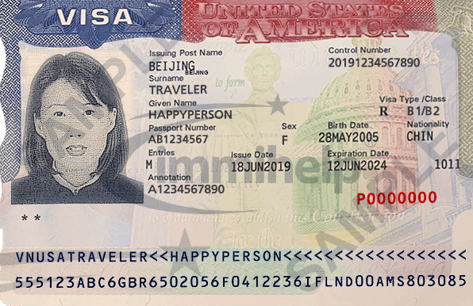
The Visa Stamp

Slide 13
Maintaining Status:
Undergraduate
Graduate
12 hours minimum
9 on-ground
3 online
Minimum 2.0 GPA
9 hours minimum
6 on-ground
3 online
Minimum 3.0 GPA

Slide 14
FINAL POINTS:
Set a schedule to check the dates on your documents
Do not seek employment off campus prior to completion of one full academic year
Watch our webinars to ensure you know what to expect and do
Email us if you have any questions. WE ARE HERE TO HELP YOU!

Slide 15
QUESTIONS?

