Slide 1

U.S. CULTURE and Culture shock

Slide 2


What Is Culture Shock?
Culture shock is the feeling you have when suddenly in an unfamiliar place, culture or way of life.

Slide 3

HOW TO ADDRESS PEOPLE YOU DON’T KNOW WELL
American culture does not have an established custom for speaking with people of different social positions or age.
Americans are more informal when greeting other people. Most people speak to each other using their first names.
  However!
When speaking to someone with a title, such as Professor or Doctor, it is more appropriate to use their title when speaking to them until you know them well. For example, “Professor Smith, how are you?”
When meeting someone for the first time, they will inform you how they like to be addressed. Some professors will want to be addressed by their title, others by their first name.

Slide 4
Culture shock-What to do
While most feelings of culture shock do not last very long. However, culture shock can lead to loneliness, homesickness, or even depression. Culture Shock is real.
If you are struggling with culture shock, it is important to remember that there are adjustment strategies and resources available if you need help finding your place. The MTSU Counseling Center has free services for students.

Slide 5
How Can I Deal With Culture Shock?
First, remind yourself that it is perfectly normal to experience culture shock. Just about everyone who moves somewhere new feels a little out of place, and it does not matter how old they are or what country they call home. If you are having trouble adjusting, here are some tips for adapting to a new culture:
Stay Positive
Remember, Culture Shock Passes
Be Social
Know Yourself and Give Yourself a Break
Talk to someone
Make use of the MTSU counseling center

Slide 6
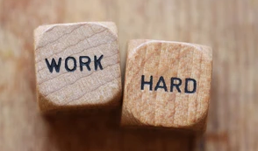
WORK ETHIC
Many Americans judge success by how many hours you devote to your work, school or project.
Although, a normal work week for a full-time job is 40 hours a week, for many industries you are expected to work more especially at the beginning of your career.
For school, there is the same mentality to work hard to get good grades, graduate with your degree, build your resume, and get good references from your professors.

Slide 7
Academic Culture Differences
Interactive Learning:
Professors encourage active participation and critical thinking rather than rote memorization. Sharing your viewpoint is valued as much as getting the “right” answer.
Open Communication:
Students are free to question, discuss, or respectfully challenge professors’ ideas. Expressing your thoughts shows engagement, not disrespect.
Independent Study:
You are expected to manage your own time, complete readings, and work on projects without constant reminders. Self-discipline is key.
Group Collaboration:
Many classes include group assignments where you work with peers from diverse cultural and academic backgrounds. Teamwork and contribution are graded.
Strict Academic Integrity:
Plagiarism or copying is treated very seriously. Always cite your sources using APA or MLA style and submit original work only.
Notes:
It’s a New Slide Altogather

Slide 8
Academic Culture Differences
Continuous Evaluation:
Grades are based on a mix of quizzes, class participation, projects, and presentations not just final exams.
Critical Thinking & Application:
Classes often focus on applying theories to real-world cases or data-driven situations rather than memorizing definitions.
Notes:
it’s a new slide

Slide 9

THE VALUE OF TIME
Americans treasure their time.
You’ve probably heard the phrase, “time is money,”
When Americans talk about time, the time is not a general estimate, but an exact expectation.
For example, in the USA it is expected that when meeting someone you show up at that exact time.
Arriving 10 minutes late or later, without notifying the person you are meeting, is not socially acceptable and can be considered impolite.
For class, arrive at least 10 minutes early if you can
Some professors deduct points for being late
Notes:
Strict Academic Deadlines:
Professors expect all assignments, projects, and papers to be submitted on or before the due date.
Extensions are rarely granted unless requested well in advance and with a valid reason.
Tip: Submitting work early shows responsibility and builds a positive impression with professors.
Precision in Schedules:
Classes, appointments, and meetings usually start and end exactly on time. Arriving late, leaving early, or skipping sessions can affect participation grades and reputation. Some professors lock the door once the lecture starts or deduct marks for tardiness.
Planning & Time Management:
Most students use digital planners, calendar apps (Google Calendar, Notion, Outlook) or to-do lists to stay organized.
Managing multiple responsibilities classes, part-time work, study sessions, and errands requires good scheduling habits.
Cultural Adjustment:
In many countries (like India), “on the way” may mean a flexible timeline, but in the U.S., it usually means you are literally on your way.
Over time, adapting to punctuality helps students gain credibility and trust both academically and professionally.
Balance & Prioritization:
American culture emphasizes balancing academic work, jobs, and social commitments efficiently. Students quickly learn to “prioritize tasks”, meet goals, and avoid last-minute stress.

Slide 10
Personal space
Each culture has a different notion of personal space.
If you intrude into someone’s personal space, you will make them feel uncomfortable, unless you are a very close friend.
Americans tend to require more personal space than people from other cultures. If you approach Americans too closely, they will back away from you.
Do not touch their face or put your arm around their shoulder. It is ok to shake hands when you first meet, but only for a brief time.

Slide 11
Independence & Daily Life
Living Away from Family:
For many international students, this is the first experience living completely on their own. Managing cooking, cleaning, and self-care without family support can feel overwhelming at first but it builds confidence and life skills.
Managing Finances:
You must create and follow a ‘monthly budget’ for rent, groceries, utilities, and transportation. Unlike in many countries, bills such as Wi-Fi, electricity, and phone plans are paid individually and on time each month.
Tip: Track expenses with budgeting apps like Mint or Google Sheets.
Cooking and Food Habits:
Eating out daily is expensive, so most students learn to cook simple meals. Batch cooking or meal prepping for the week saves both time and money.
You’ll also learn how to shop efficiently, comparing prices, using coupons, and buying groceries in bulk from stores like Walmart or Costco.
Notes:
Entirely New Slide

Slide 12
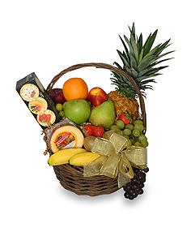

Informal gatherings
Spontaneous invitations to informal gatherings are common.
If invited to dinner at someone’s home, as opposed to a restaurant, it is OK to bring a small gift, such as a bottle of wine or flowers for the host.
The situation guides what you take when visiting someone.

Slide 13
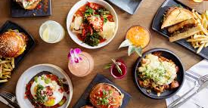


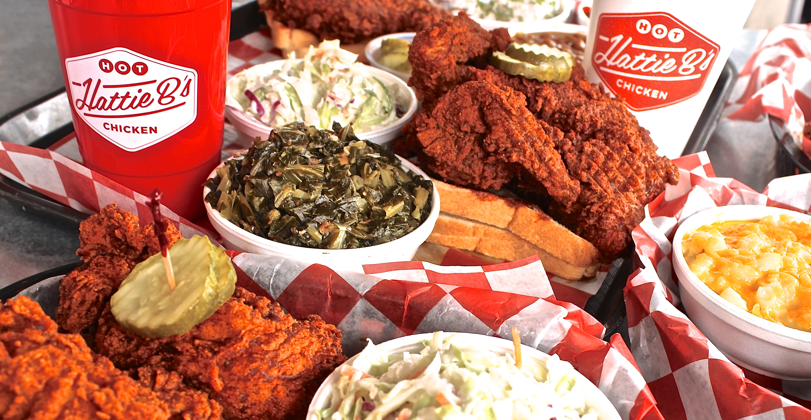
Food
American Meal System
Breakfast – usually around 7:00am
Lunch- Noon
Dinner- Around 6:00pm
Recently, it is expected that you order something when spending time in a restaurant or studying in a coffee shop.

Slide 14
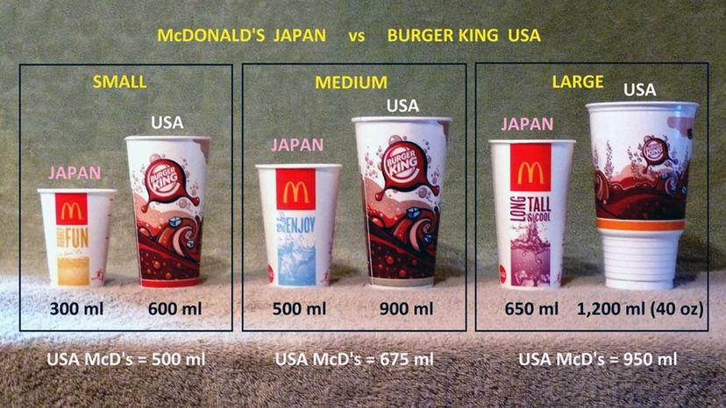
Drink sizes and unlimited refills

Slide 15
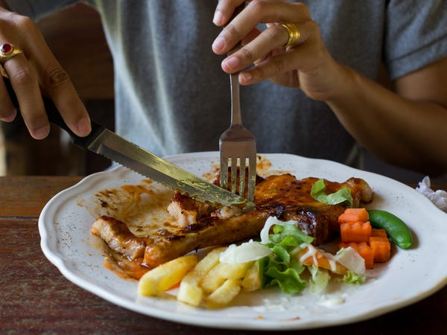
Serving sizes are huge

Slide 16
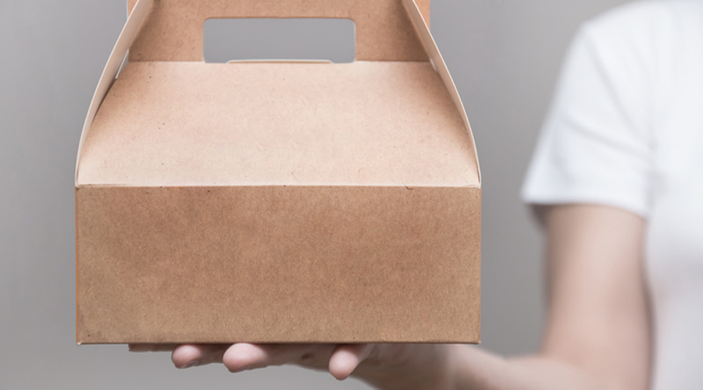
Taking leftovers home

Slide 17
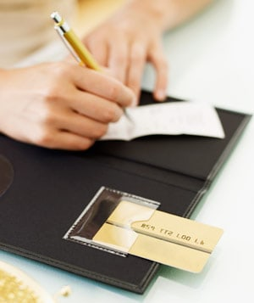
Giving a credit
card to the
waiter
or waitress

Slide 18
Positive Side of Cultural Shock
It helps you grow emotionally and professionally.
You become more open-minded, adaptable, and confident.
You start appreciating both your home culture and global perspectives.
Most students later say: “Culture shock made me stronger and more independent.”
Notes:
Completely New Slide

Slide 19
Interesting Facts About Culture Shock
It Happens to Everyone:
Even the most well-traveled people experience culture shock — it’s a psychological adjustment process, not a lack of preparation.
There Are 4 Stages of Culture Shock:
🥰 Honeymoon Stage – Excitement and curiosity about everything new.
😖 Frustration Stage – Confusion or homesickness sets in.
😊 Adjustment Stage – Gradually adapting to new routines.
💪 Acceptance Stage – Feeling confident and comfortable in the new culture.
Reverse Culture Shock Exists Too:
When students return home, they sometimes feel out of place in their own country after adapting to U.S. life this is called reverse culture shock.
Notes:
Entirely New Slide

Slide 20
Interesting Facts About Culture Shock
Culture Shock Can Affect the Senses:
It’s not just emotional But people may react physically too (trouble sleeping, craving familiar foods, or feeling tired easily).
Language Barriers Are a Major Trigger:
Even fluent English speakers can struggle with accents, slang, or humor :understanding idioms like “break a leg” or “hit the books” takes time!
Food Is the Fastest Way to Feel at Home:
Many international students say cooking dishes from home or visiting cultural restaurants helps them cope with homesickness.
Americans Smile… A Lot! 😄
In many cultures, smiling at strangers is rare in the U.S., it’s a common friendly gesture, which can feel confusing at first.
Notes:
Entirely New Slide

Slide 21
Interesting Facts About Culture Shock
“How Are You?” Isn’t Always a Real Question:
It’s a casual greeting, not an invitation to share personal details. A simple “I’m good, thanks!” works best.
Small Talk Is a Big Deal:
Conversations about the weather, sports, or weekend plans are social connectors; they help people build rapport.
Humor Differs by Culture:
Sarcasm, irony, or self-deprecating jokes are very common in the U.S., and it can take time to interpret them correctly.
Students Often Miss Background Noise:
Many newcomers say they miss the “buzz” of busy streets, family conversations, and festivals back home. U.S. towns may feel quiet by comparison.
The Shock Fades & Growth Stays:
Culture shock eventually disappears, but it leaves behind stronger communication skills, independence, and emotional maturity.
Notes:
Entirely New Slide

Slide 22

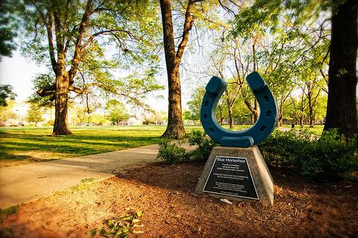

Q & A

