Slide 1

Next Steps
Graduate Admission
Notes:
Welcome everyone! This presentation will walk you through the essential next steps for newly admitted international graduate students.
We’ll cover topics like immigration documents, housing, scholarships, orientation, and more.

Slide 2

Topics
I-20
Student Accounts (PipelineMT and email)
Graduate Assistantships
Immunizations
Housing
International Orientation (mandatory)
CGS Orientation (optional)
Contacting your advisor/program
Deferrals/Change of program request
Notes:
Here’s a quick overview of what we’ll cover today.
Each item is a key step in preparing for your graduate studies at MTSU.
Feel free to jot down questions as we go—we’ll have time for Q&A at the end.

Slide 3
I-20
Issued once you have been:
-Admitted into your degree program
-We have received a copy of passport, signed Financial Support Form, financial documents
Financial Documents:
Bank statements
Assistantship award letter
Scholarship award letter
Notes:
The I-20 is your official document for obtaining an F-1 visa.
It’s issued after admission and once we receive your passport, financial support form, and financial documents.
These documents can include bank statements, assistantship offers, or the IMS

Slide 4
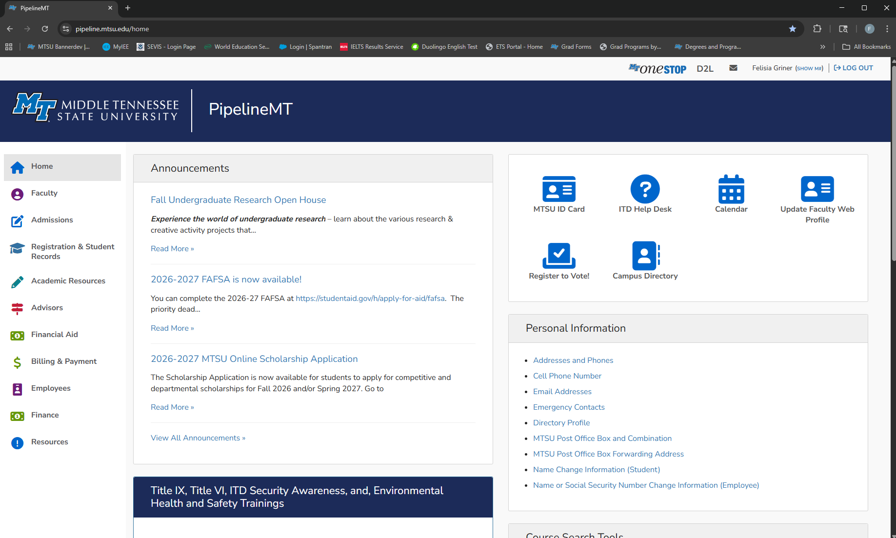
Student Account
PipelineMT
https://pipeline.mtsu.edu/home
Notes:
PipelineMT is your student portal for accessing your account, registration, and more.
Make sure you log in and get familiar with it early.

Slide 5
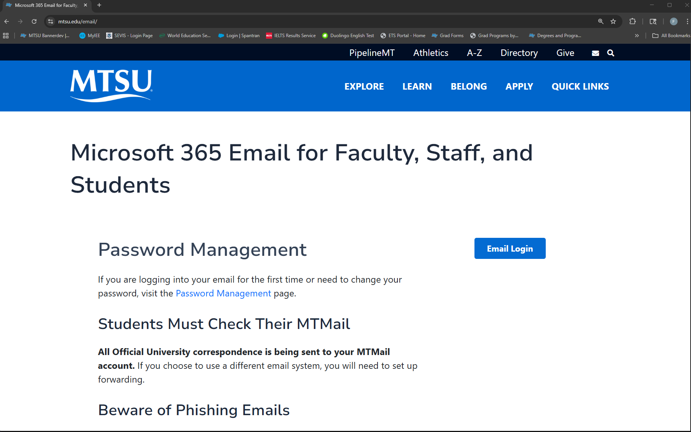
Student Account
Email
https://www.mtsu.edu/email/
Notes:
Your MTSU email is the official way we communicate with you.
Check it regularly for updates on registration, scholarships, and orientation.

Slide 6
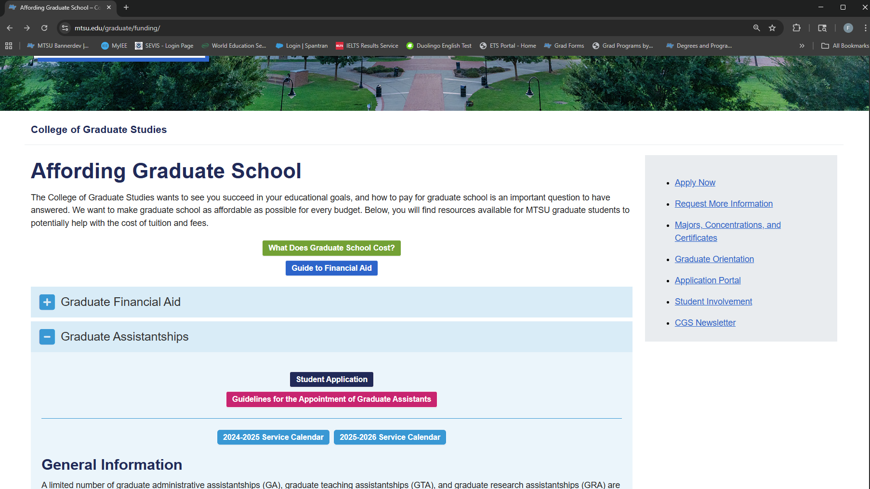
Graduate Assistantship
https://www.mtsu.edu/graduate/funding/
Apply early!
Individual application for each position,
you may apply to more than one
Contact individual office(s) for status
Student-driven process!
Notes:
Assistantships are competitive and require early application.
You can apply to multiple offices, but you must choose between an assistantship and the International Merit Scholarship.
This process is student-driven, so follow up with departments directly.

Slide 7
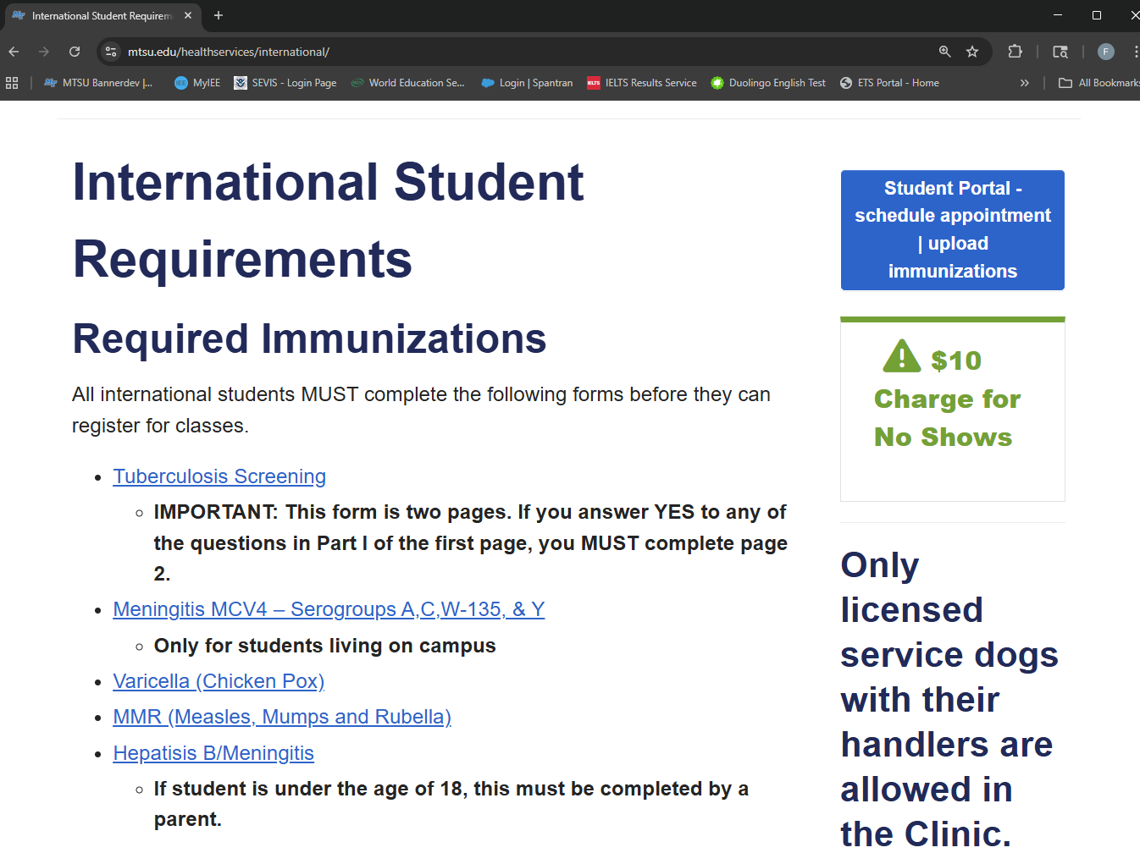
Immunizations
All F-1 students must complete the immunization requirement
You must complete the immunization requirement to enroll full-time and live on campus
Follow instructions on the Student Health Services website
Notes:
All F-1 students must meet immunization requirements to enroll full-time and live on campus.
Visit the Student Health Services website for instructions.

Slide 8
Housing
On Campus:https://www.mtsu.edu/living-on-campus/
You are not required to live on campus
Apply early as housing fills up fast
Immunizations required
Off Campus:https://offcampushousing.mtsu.edu/listing
Many options available
Student-driven – our office is unable to assist with housing
YOU ARE RESPONSIBLE FOR THE HOUSING CONTRACT YOU SIGN!
Notes:
On-campus housing is optional but fills up quickly—apply early!
Off-campus housing is available, but our office cannot assist with contracts.
Be sure to read and understand any housing agreement you sign.

Slide 9
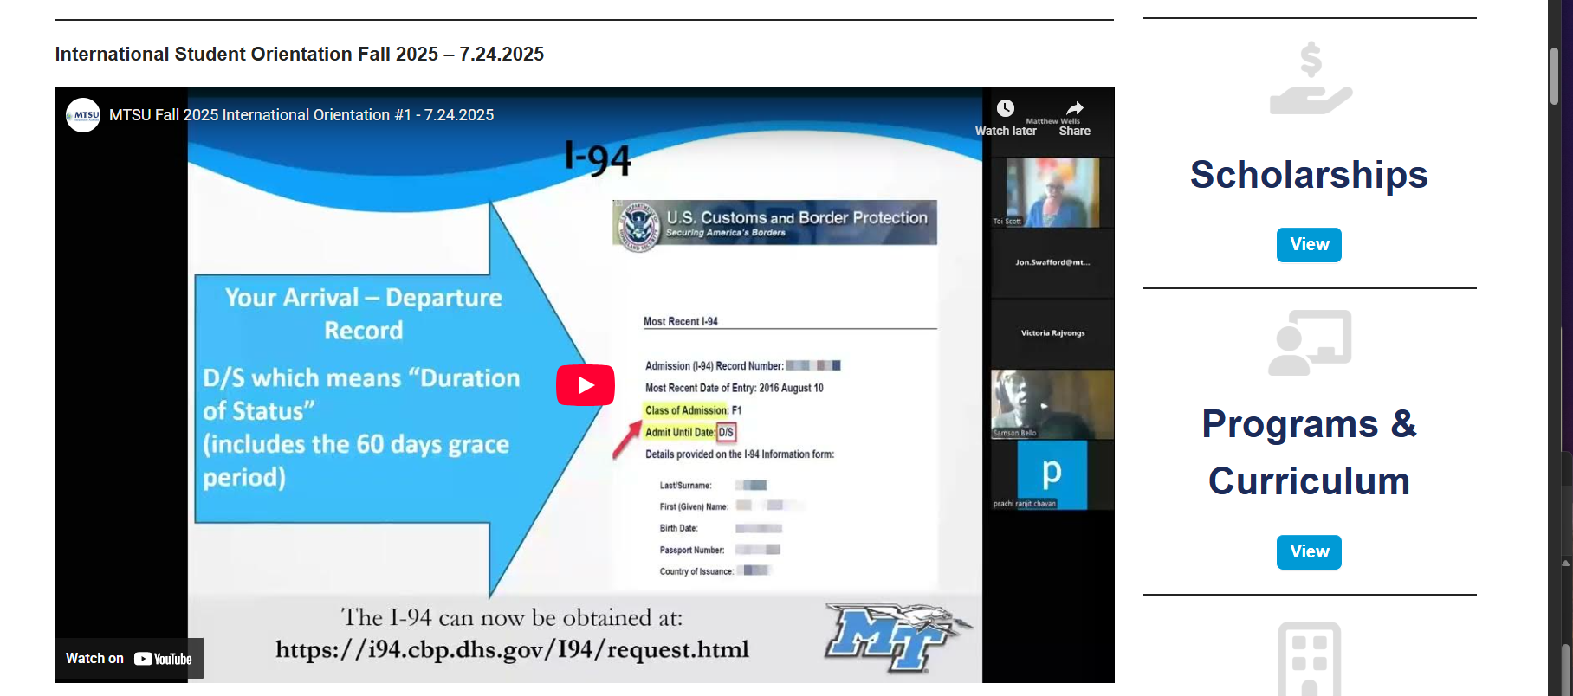
International Orientation
Required for all F-1 students
International Orientation Webinars - https://intered.mtsu.edu/webinars/
Orientation Quiz
Upcoming webinar schedule can be found in the
Events and Activities section:
Orientation Session #1: 28 Jul 2026 – 8:00 CST
Orientation Session #2: 18 Aug 2026 – 8:00 CST
All F-1 students must complete this requirement. A registration hold will prevent you from adding to, or changing your schedule if not completed by the hold date
Notes:
This orientation is mandatory for all F-1 students.
You must attend webinars and complete the orientation quiz.
A registration hold will be placed if you don’t complete it by the deadline.

Slide 10
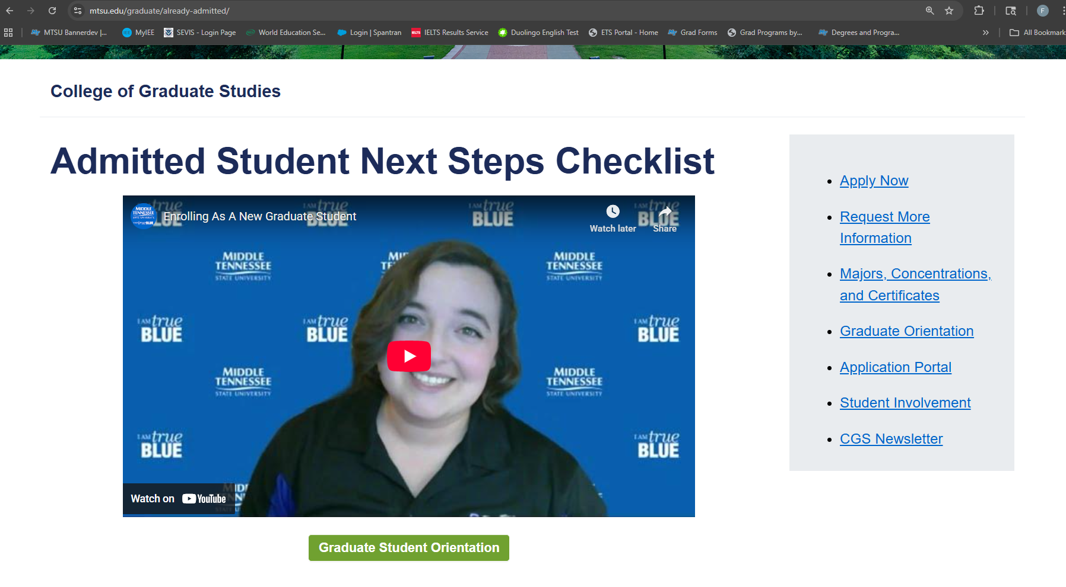
College of Graduate Studies (CGS) Orientation
https://www.mtsu.edu/graduate/already-admitted/
Not required, but is EXTREMELY helpful
Notes:
The College of Graduate Studies orientation is optional but very helpful.
It provides valuable insights into graduate life and resources at MTSU.

Slide 11
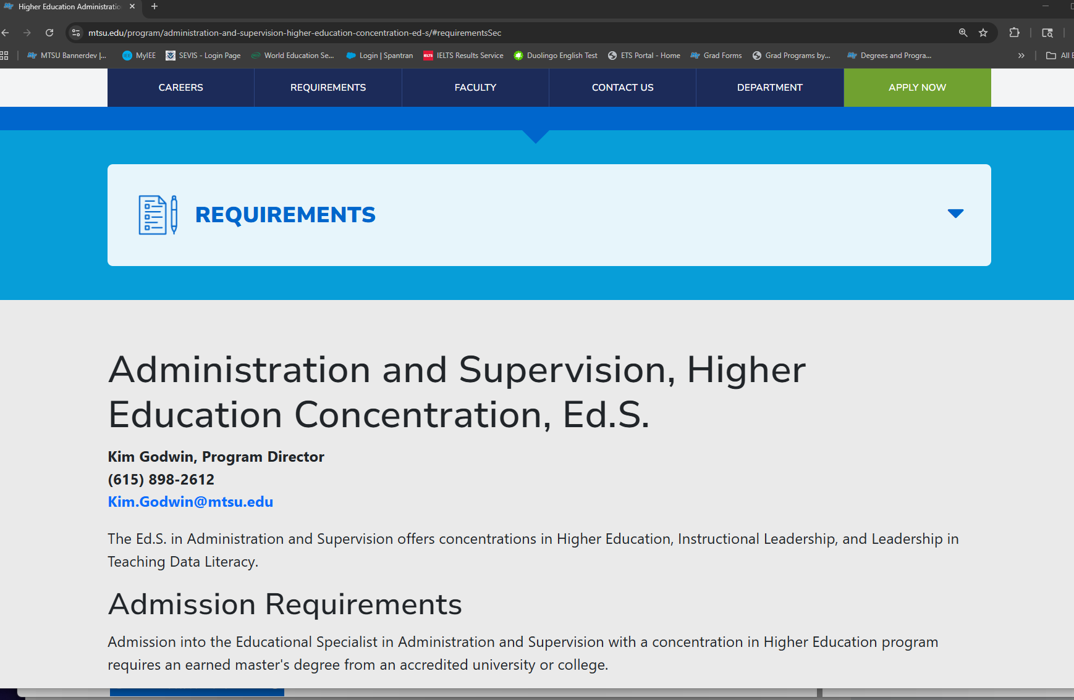
Contact Advisor/Program
HIGHLY encouraged
Additional program requirements
Confirm admission acceptance
Course selection and academic advising
Notes:
Contacting your advisor is highly encouraged.
They’ll help you confirm your admission, guide course selection, and share any program-specific requirements.

Slide 12
Deferring Admission/Changing Programs
Withdraw your current application and submit a new application for the term you plan to attend and/or your intended degree program
No application fee required*
Previously submitted transcripts/test scores will be applied to your new application
May apply previously submitted reference letters to new application as well
Program-specific materials must be uploaded separately
Note:
Meeting minimum requirements for program admission does not guarantee admission, as applicants are selected on a competitive basis.
Previous decisions do not apply to the new application
*if previously paid and the application is for the same level
Notes:
If you need to defer or change your program, withdraw your current application and submit a new one.
No new fee is required if it’s for the same degree level.
Previously submitted official documents can be reused, but program-specific materials must be re-uploaded.

Slide 13
Resources
PipelineMT: https://pipeline.mtsu.edu/home
Email: https://www.mtsu.edu/email/
Graduate assistantships: https://www.mtsu.edu/graduate/funding/
Search for Programs: https://www.mtsu.edu/search-program/
Deferring your application: https://apply.mtsu.edu/apply/
Housing: https://www.mtsu.edu/living-on-campus/
Off-Campus Housing: https://offcampushousing.mtsu.edu/listing
Immunizations: https://www.mtsu.edu/healthservices/international/
Registration Guide: https://www.mtsu.edu/registration/registration-guide/
Webinars: https://intered.mtsu.edu/webinars/
Notes:
This slide includes links to all the resources mentioned today.
Bookmark these for easy access to housing, immunizations, assistantships, and more.

Slide 14
Bill Pay - Timeline
July 10th – Bills Posted
August 10th – “Soft” Fee Payment Deadline*
August 17th – Fee Payment Deadline
August 24th – Fall semester begins
Notes:
This slide includes links to all the resources mentioned today.
Bookmark these for easy access to housing, immunizations, assistantships, and more.

Slide 15
Bill Pay - Timeline
Registration Guide
Bursar’s Office
One Stop
International Affairs
Notes:
This slide includes links to all the resources mentioned today.
Bookmark these for easy access to housing, immunizations, assistantships, and more.

Slide 16
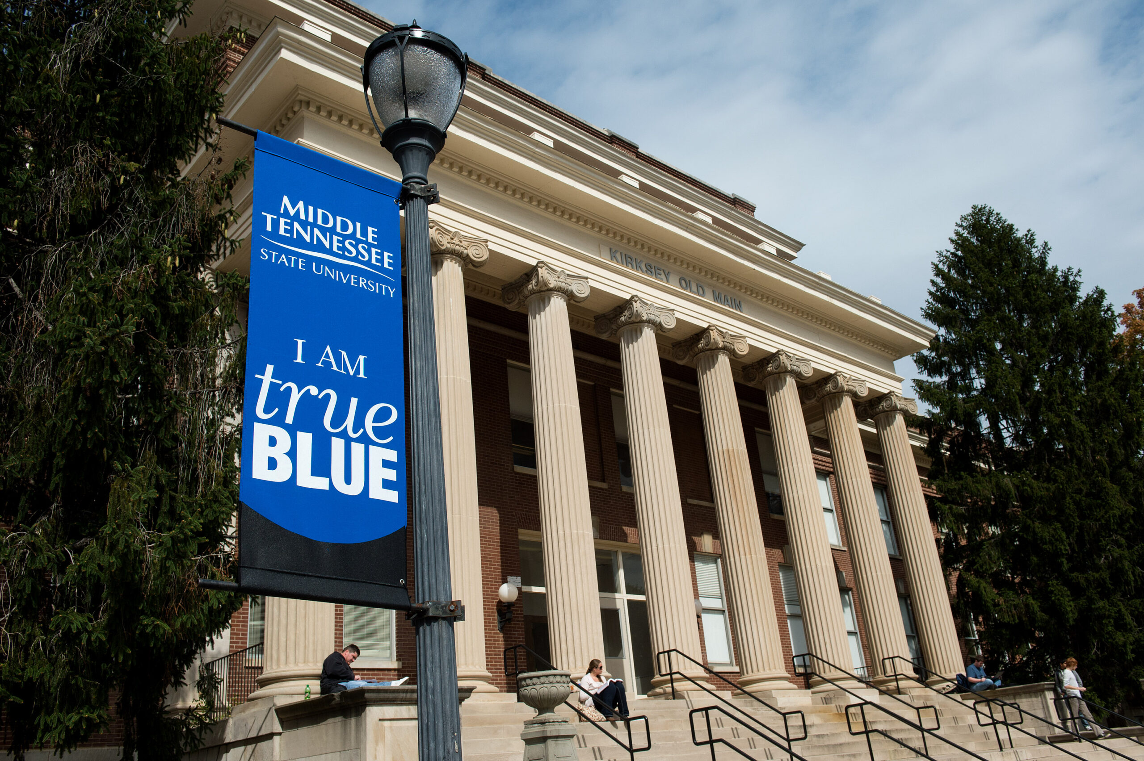
International Payments
Flywire and PayMyTuition
Instructions on the Bursar’s Office page
Multi Language Customer Support
Can be done from home
Notes:
This slide includes links to all the resources mentioned today.
Bookmark these for easy access to housing, immunizations, assistantships, and more.

Slide 17
Recap:
I-20​ - what is needed
Student Accounts​ - how to access
Contacting your Advisor/Program​ - where to find info, confirm acceptance, program specific info
Graduate Assistantships​ - student driven – submit app(s) and contact office of interest
Immunizations​ - must complete to register full time
Housing​ - student-driven – not required to live on campus
International Orientation (mandatory)​ - must complete to remove registration hold
CGS Orientation (optional)​ - not required, but is good information
Deferrals/Change of program request​ - be aware of program-specific requirements
Notes:
This slide includes links to all the resources mentioned today.
Bookmark these for easy access to housing, immunizations, assistantships, and more.

Slide 18
Questions?
Notes:
Now it’s time for your questions!
Feel free to ask about anything we covered or other concerns you may have.

