Slide 1

Next Steps:
Undergraduate
International Affairs
July 7, 2026
Fall 2026 Semester

Slide 2

Next Steps
Overview
I-20 Issued
Student Accounts
Placement Tests
New to Blue Orientation
Housing and Immunizations
International Check In

Slide 3
I-20
Financial Statement Form
Financial Support Document ($36,500)
Passport

Slide 4
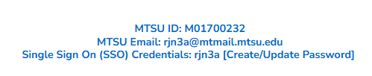



Student Accounts
Update account from your application portal
SSO for several platforms: MT Mail, Pipeline,
Health Services, Housing, etc.
Will only receive official correspondence through MT Mail

Slide 5

Placement Tests
Required for students to enroll
Virtual and In-person options
May be exempt with SAT or ACT scores
Complete these EARLY

Slide 6
Placement Tests
Process
Contact University Studies: University.studies@mtsu.edu
Student sent checklist and link to English Survey
Once checklist complete, voucher is sent to students
Must pay test fee to Accuplacer ($28) and MTSU ($25)
University Studies sends results

Slide 7
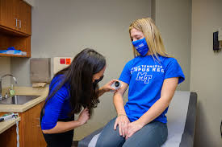
Immunization Requirements
Must have Varicella and MMR immunizations to register full time
Must have Meningitis immunization to live on campus
Can submit documentation to Health Services
Can receive immunizations upon arrival

Slide 8

New to Blue Orientation
Register on Pipeline
Meet with Advisor
Register for Courses
Online Modules
This is a new process
Email Orientation@mtsu.edu if you have questions!

Slide 9
New to Blue Orientation
July 15th
August 4th

Slide 10
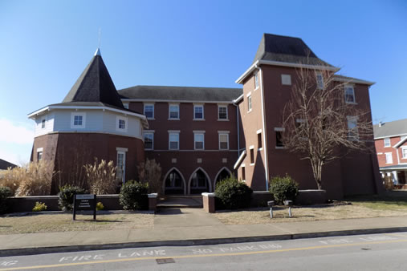
Housing
Not required to live on campus
Separate application to live on campus
Off campus options available, many very close
We cannot get you housing

Slide 11
Bill Pay - Timeline
July 10th – Bills Posted
August 10th – “Soft” Fee Payment Deadline*
August 17th – Fee Payment Deadline
August 24th – Fall semester begins
* Courses are marked for deletion if payment is not made but are not deleted!

Slide 12
Bill Pay - Resources
Registration Guide
Bursar’s Office
One Stop
International Affairs

Slide 13

International Payments
Flywire and PayMyTuition
Instructions on the Bursar’s Office page
Multi Language Customer Support
Can be done from home

Slide 14
International Check-In
Digitally submit Visa, I-94, and signed I-20*
Attend International Orientation
Sign up for Welcome Week events
*These can be sent to International@mtsu.edu

Slide 15
Upcoming Webinars
July 14- Visa Interview and Pre-Arrival
July 21st – Campus Life
August 4th – Bill Pay
August 11th – Pre-Arrival and Welcome Week

Slide 16
International Orientation
July 28th
August 18th

Slide 17

Questions?

