Slide 1

Next Steps
International Affairs
November 3, 2026
Spring 2027 Semester

Slide 2

Next Steps
Overview
All Students
Undergraduates
Graduates

Slide 3
Next Steps
All Students
I-20
Student Accounts
Housing
Immunizations
Check-In
International Orientation
Deferrals

Slide 4
I-20
Financial Statement Form
Financial Support Document ($36,500)
Passport

Slide 5
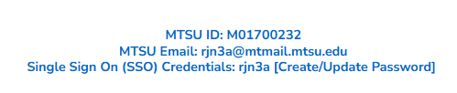



Student Accounts
Update account from your application portal
SSO for several platforms: MT Mail, Pipeline,
Health Services, Housing, etc.
Will only receive official correspondence through MT Mail

Slide 6
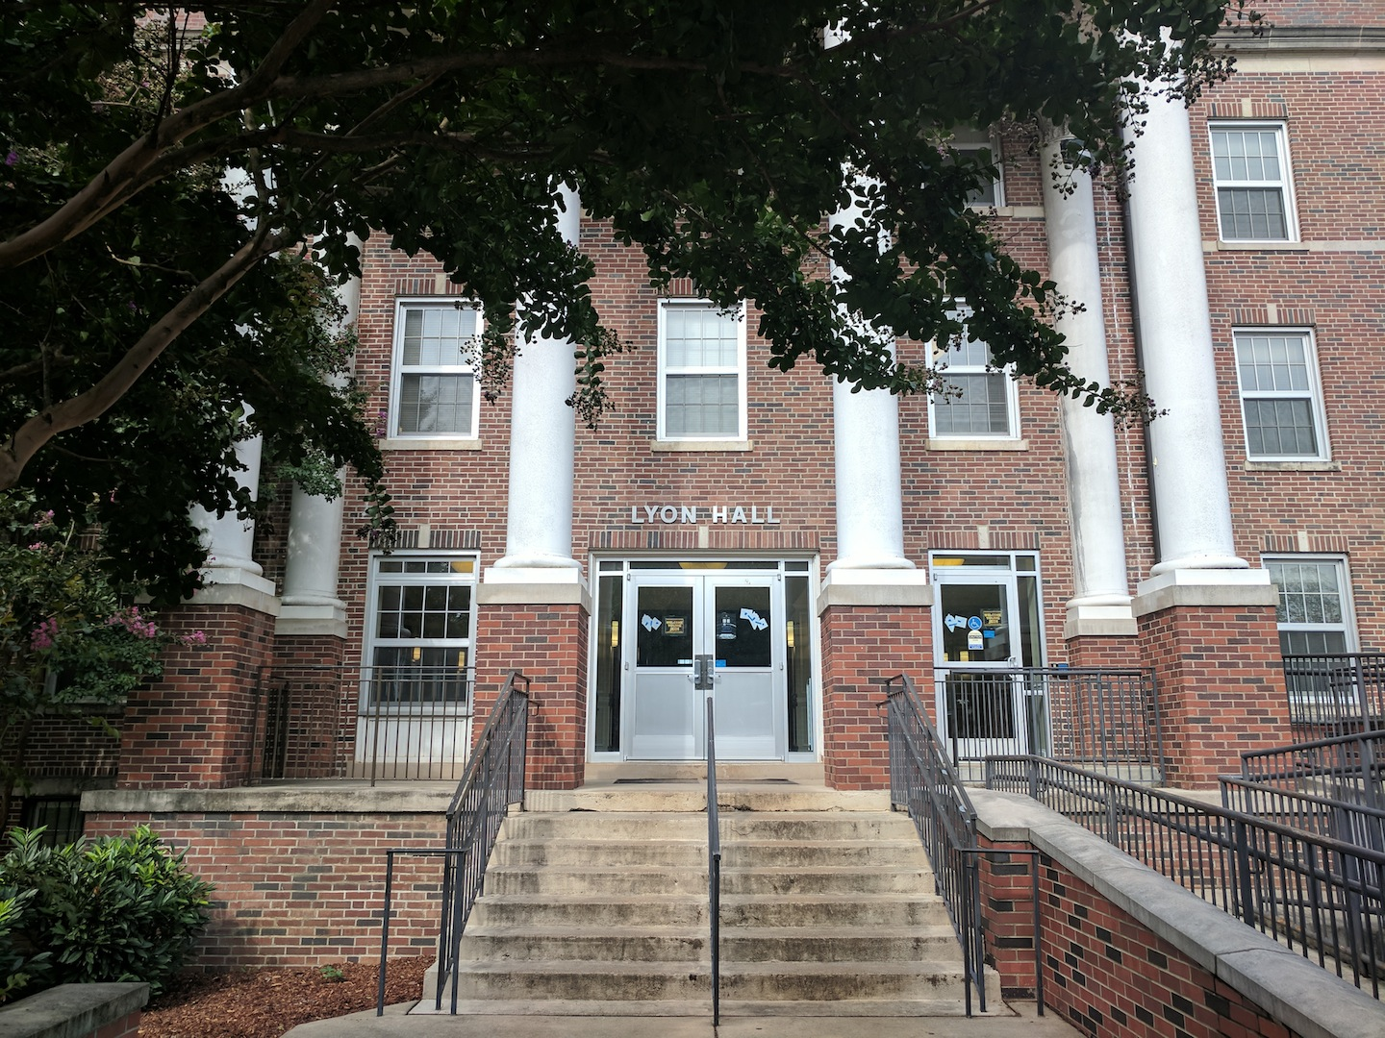
Housing
Not required to live on campus
Separate application to live on campus
Off campus options available, many very close
We cannot get you housing
https://offcampushousing.mtsu.edu/listing for off campus housing information

Slide 7
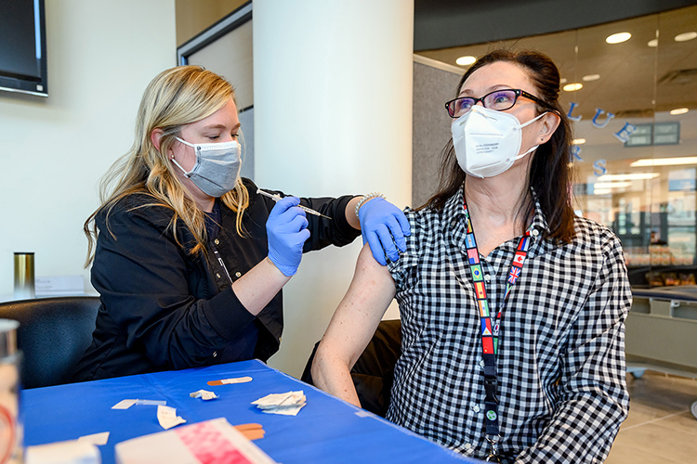
Immunization Requirements
Must have Varicella and MMR immunizations to register full time
Must have Meningitis immunization to live on campus
Can submit documentation to Health Services
Can receive immunizations upon arrival

Slide 8
International Check-In
Signed I-20
Visa
I-94
U.S. Address
*These can be sent to International@mtsu.edu

Slide 9
International Orientation Dates
December 17
January 12

Slide 10
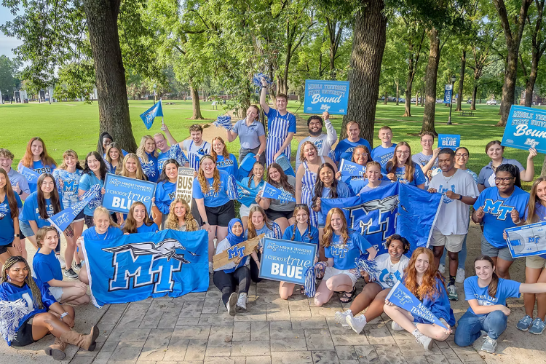
International Orientation
Attendance is mandatory for all students attending on the F-1 visa
Includes important information about compliance, academic integrity, and insurance
A hold is placed on your account that will prevent registration until this is completed
Only attend 1 session!

Slide 11
Deferrals
Undergraduate Students:
Request on your application portal or send our office an email requesting deferral to next semester
Graduate Students:
Withdraw your current application and submit a new application for the term you plan to attend and/or your intended degree program
No application fee required*
Previously submitted transcripts/test scores will be applied to your new application
May apply previously submitted reference letters to new application as well
Program-specific materials must be uploaded separately
Note:
Meeting minimum requirements for program admission does not guarantee admission, as applicants are selected on a competitive basis.
Previous decisions do not apply to the new application
*if previously paid at the same level

Slide 12
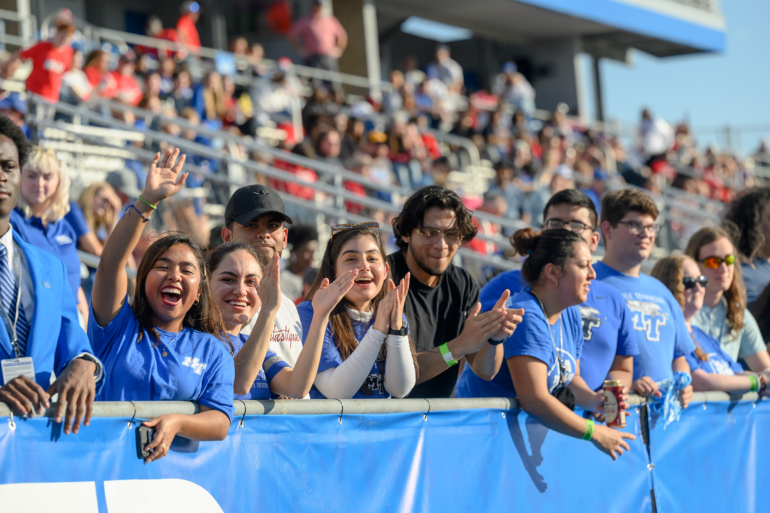
Next Steps: Undergraduates
Placement Tests
New to Blue Orientation

Slide 13

Placement Tests
Required for students to enroll
Virtual and In-person options
May be exempt with SAT or ACT scores
Complete these EARLY

Slide 14
Placement Tests
Process
Contact University Studies: University.studies@mtsu.edu
Student sent checklist and link to English Survey
Once checklist complete, voucher is sent to students
Must pay test fee to Accuplacer ($28) and MTSU ($25)
University Studies sends results

Slide 15
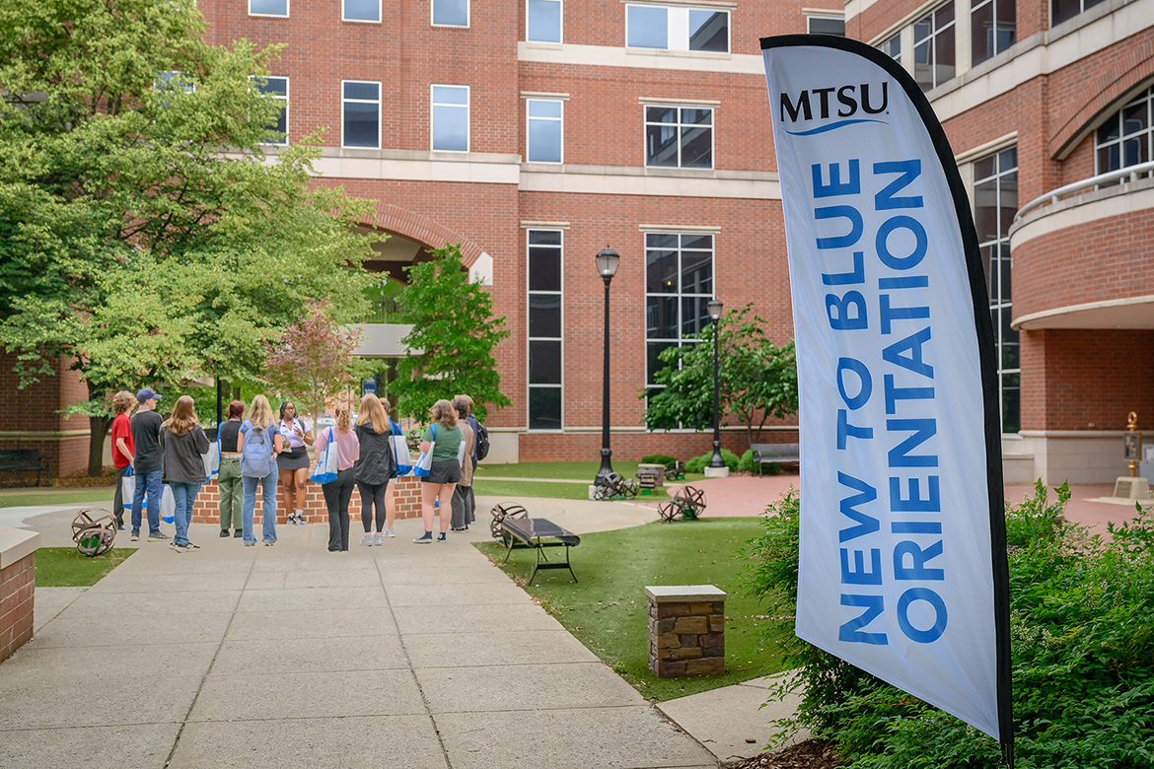
New to Blue Orientation
Register on Pipeline
Meet with Advisor
Register for Courses
Online Modules
This is a new process
Email Orientation@mtsu.edu if you have questions!

Slide 16

New to Blue Orientation
November 19th – Virtual Session

Slide 17
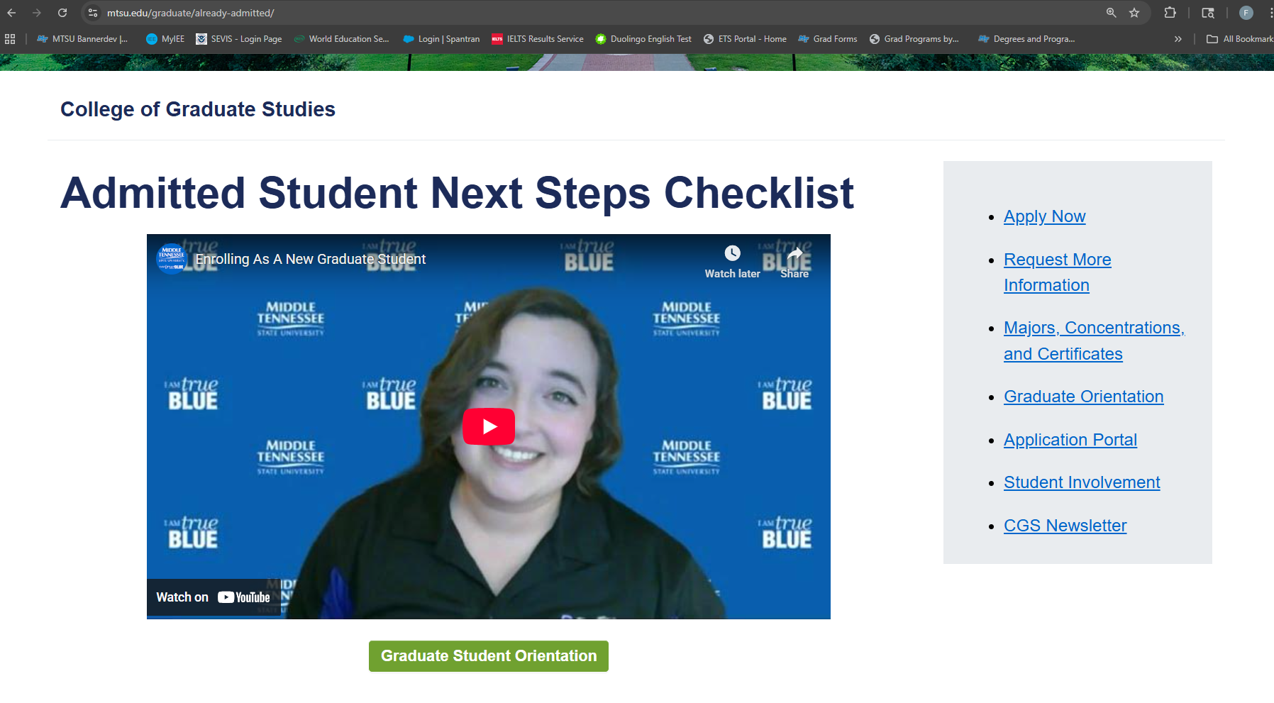
Next Steps: Graduate Students
College of Graduate Studies (CGS) Orientation
https://www.mtsu.edu/graduate/already-admitted/
Not required, but is EXTREMELY helpful

Slide 18
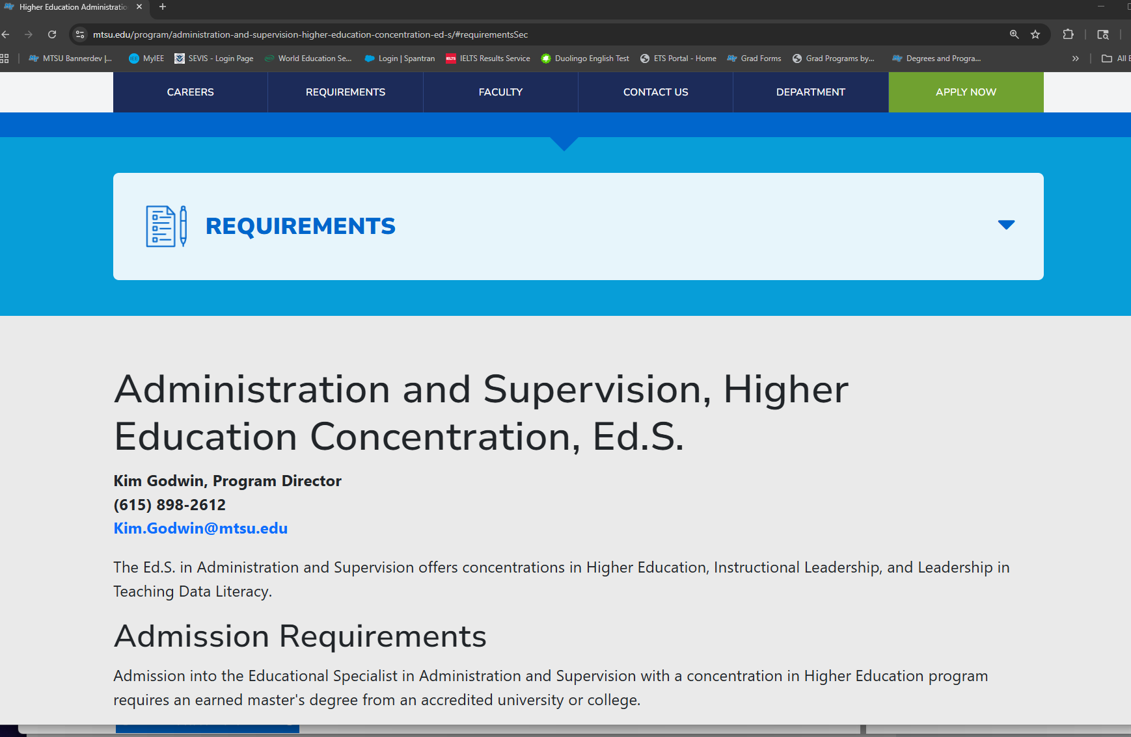
Next Steps
Contact Advisor/Program
HIGHLY encouraged
Additional program requirements
Confirm admission acceptance
Course selection and academic advising

Slide 19
Upcoming Webinars
November 12 Visa Interview
November 17 Area Tour and Open Session
November 24
Bill Pay and Student Services
December 8
Visa Interview
December 22 Pre-Arrival
January 7
Culture Shock

Slide 20

Questions?

